Slide 1


It’s Going to Be Okay! Explore & Focus Phase Curriculum & Career Planning: Student Q&A
Curriculum & Career Advising
Gina Franco, she/her/hers
Assistant Director, Clinical Curriculum
Tonja Brown, she/her/hers
Career Advisor
September 10, 2026

Slide 2



Today’s Focus
Goals
Present an overview of E&F curriculum
What to expect from Career Advising
Improve your understanding of elective selection & resources
Support your understanding of tools & resources used in the process
Address areas where students commonly feel stress
Answer your questions!

Slide 3
Overview: Explore & Focus Phase Curriculum
CLERKSHIP Requirements in the E&F
  Emergency Medicine (4-wks, 8 credits)
  Neurology/Neurosurgery (4-wks, 8 credits)
  Advanced Patient Care Clerkship (8-wks total, 16 credits)
    Advanced Patient Care Sub-Internship (4-wks, 8 credits)
  Clinical Electives (20-wks total, 40 credits)
    Mix of both 2- and 4- week clerkships (with some limited exceptions)
    Includes Special Assignment Electives, aka, Away rotations
36 total weeks of requirements for your clerkships
52 total weeks to take clerkships in E&F
  (52 weeks does not include Integration Weeks, Transition to Residency and breaks)

Slide 4
Sub-Is, APCs, Clinical Electives- what are they?
  Opportunity to engage in a clinical rotation that provides exposure to various specialties for career development and exploration​
  With appropriate supervision, participate in patient care as a supporting member of the care team under the direction of a primary clinician (usually a fellow or resident)
  2-or 4-week full-time clerkships​
  8-credit clinical rotation where students act at an advanced level ​
  Primary responsibility for aspects of patient care with appropriate supervision​
  Demonstrate independence and an ability to think critically and other skills necessary to transition to residency​
  Subcategory of APCs ​
  Student functions more like an intern in preparation for residency​
  Responsible for the care of patients​
  Integral part of team in a primary rather than consultative role​
CLINICAL ELECTIVE
ADVANCED PATIENT CARE CLERKSHIP (APC)
ADVANCED PATIENT CARE CLERKSHIP- SUBINTERNSHIP(APC-S)

Slide 5
Credit Distribution for Electives
Credit for SOM Graduation Requirements is granted chronologically
  Your first APC-S taken will count towards your APC-S requirement
  Your first APC taken will count towards your APC requirement*
If you have multiple APC-Ss on your schedule:
  *A second chronological APC-S will count towards your APC requirement IF you haven’t already met the APC requirement
  If you have already met your APC requirement, any subsequent APC-Ss will count towards clinical elective credit
If you have multiple APCs on your schedule:
  The next chronological APC after you have met your requirement will count towards clinical elective credit

Slide 6
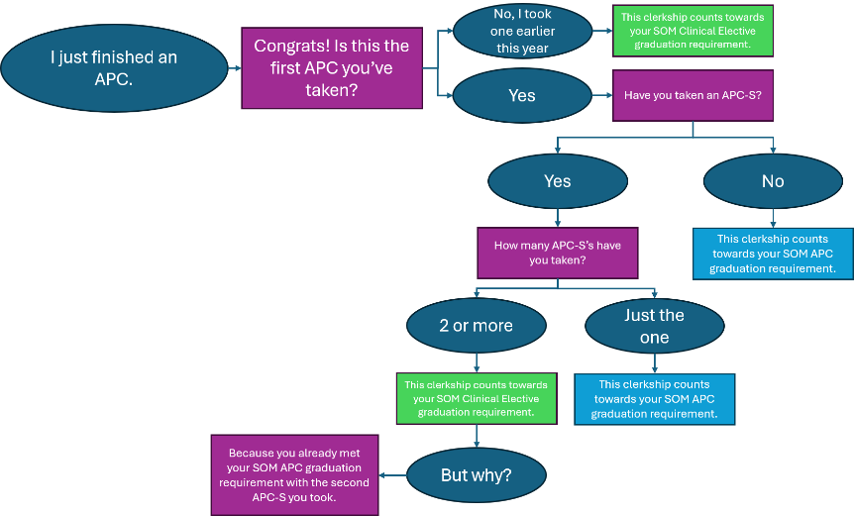
Credit Distribution, APC Flowchart

Slide 7
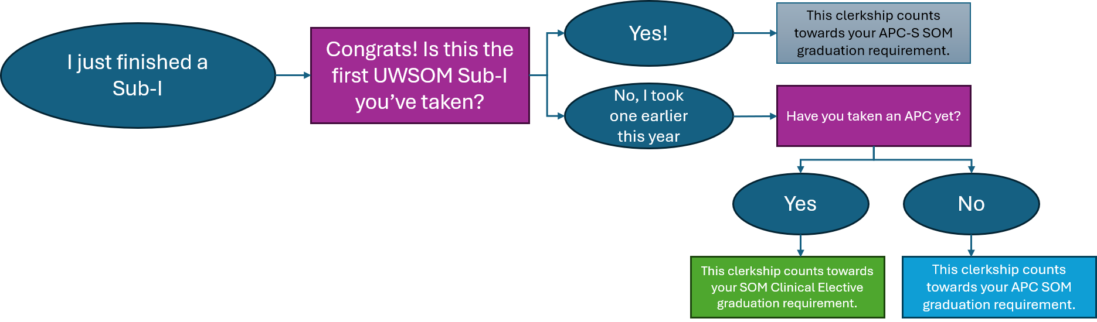
Credit Distribution, APC-S Flowchart

Slide 8
Overview: E&F Phase Curriculum, cont.
Difference in the E&F Phase from other phases
  Foundations and Patient Care phases are generally lockstep curriculum
  E&F is flexible: schedules can be changed to accommodate specialty exploration and preparation for residency
Why do we need a full schedule if we aren't sure of our needs right now?
  Registration needs to ensure everyone has a full schedule, but you can adjust your schedule throughout the year up until graduation (up to 6 weeks prior to the start date)
    As interests develop, come back to reg process to see what is available
      Visit eValue and E&F Clerkship Catalog often!
    Talk w depts – make relationships – space may open in rotations that were previously closed or more rotations may come available
    Read communications coming from departments about their processes
This is intentionally an iterative process. Be planful and flexible; adjust your schedule as you get new information.

Slide 9
Career Planning in E&F: What Comes Next
From Oct.-Dec. Career Advising meets with every student planning to graduate in 2028
Your dedicated career advisor will email you at the end of September with instructions for scheduling an “Explore & Focus Phase Career Planning Appointment”
Prior to your appointment, you will be asked to set aside time (minimum 2 hours) to complete preparation steps

Slide 10
Career Planning in E&F: Required Preparation
Read ALL of the content on:
  Explore & Focus Phase Career Planning webpage, including the PDF: Career Planning for Explore & Focus: Specialty Planning & Residency Application
  Specialty Guides: "Explore & Focus Phase Planning" content for the specialties you are considering for residency
Download and complete a draft of your Clinical Phase Planning Worksheet
Upload your Planning Worksheet to your appointment with your career advisor (you can go back and add the worksheet after you book the appt.)

Slide 11
Have You Experienced Any of These Challenges?
Don’t wait! Schedule your E&F Phase Career Planning appointment in late-Sept., Oct., or early-Nov.
  Finishing Patient Care Phase 6-12 weeks after standard end time (end of March 2027)
  Foundations block fail(s)
  Step 1 or Step 2CK fail; Low Step 1 or Step 2CK score; Have not taken Step 1 yet
  Clerkship exam fail(s) or clerkship fail(s)
  For clerkships graded on H/HP/P/F scale prior to Spring 2026: 2 or more Passes in Patient Care Phase. Pass in a specialty of interest.
  Expansion (non-research related) or leave of absence

Slide 12
Planning Your E&F Electives
Consult Specialty Guides: E&F Phase Planning section
Recommendations on selecting SubIs, APCs, clinical electives, aways
Planning for interview season: when not to schedule rotations
Electives Taken Before Residency Application Deadlines
Help you rule out specialties and make specialty decisions
Electives Taken After Residency Application Deadlines
Fulfill MD graduation requirements
Explore interests within and outside of your specialty
Develop skills/knowledge to prepare for intern year
E&F Phase Clerkship Catalog will guide you on if permissions are required for your elective choices
Will help with “Pre-Registration” (starting 9/14/26)
Review: Elective Selection Frequently Asked Questions website
Watch: Frequently Asked Elective Questions for MS4s video

Slide 13
Permission-only Clerkship Scheduling
Why are clerkships permission only?
  Can I check eValue for availability info for permission-only clerkships?
  Check first, always check with department
Students must obtain departmental permission to take certain clerkships
  Use the E&F Clerkship Catalog for permission information: if req. and who to contact
  Department sets permission parameters (application, first-come first-serve, etc.) and are best resources for availability information. Varies by department!
Permission pre-registration tentatively starts 9/14/26 – Registration will let you know; Don’t contact depts before, unless invited (i.e. Family Medicine)
You can always revisit your permission-only scheduling throughout the year

Slide 14
Tricks & Tips
Overwhelm Can Arise Quickly. Don’t Delay Moving Forward
  Make relationships and stay connected to the departments
  Find a friend/s in the class above you to lean on for support/advice
  Stay on top of your planning and emails
  Reach out to career advisor/mentors if you find yourself getting stuck on specialty decision making
Familiarize Yourself With & Use the Resources & Tools
  Registration Team, Departments, Career Advising, Academic Support, etc.
  Review the Appendix of this slide deck – contains the most used Curriculum & Career Advising resources
Prepare for What Comes Next:
  Lots of emails: departments, registration, career advising, academic support
  As you are seeing this week, lots of presentations and information sharing
  Schedule your career advising appointment when you hear from us

Slide 15
Inquiry Page
Time for Your Questions!

Slide 16
Appendix: Resources & Tools for E&F Phase Planning
Curriculum Resources
Career Advising Resources
Explore & Focus Phase Curricular Info
  Guide to 4th Year Planning webpage
  APC Clerkship Information
E&F eValue & User Guides
E&F Phase Clerkship Catalog
  User Guide
  Religious Accommodations Notice
Permission Only Guidance
Clerkship Phase Contacts
  Department Clerkship Contacts
  Regional Clerkship Contacts
Career Planning for E&F website
  Where you will complete your career planning appointment prep
  Download the Clinical Phase Planning Worksheet
Specialty Guides
  Advice for E&F course planning & elective selection
  Guidelines for Contacting Specialty Career Advisors (SCA)
Away Rotations
Glossary of Terms

Slide 17
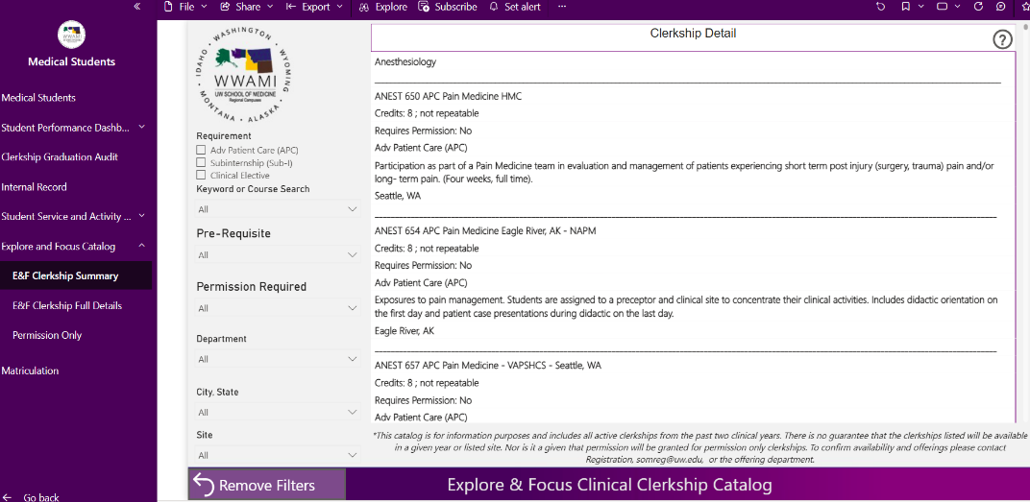
Appendix: Explore & Focus Catalog- SUMMARY
SUMMARY VIEW
Course Name
Credit Information
Permission Information
SOM Grad Requirement
Course Description
Course City/State

Slide 18
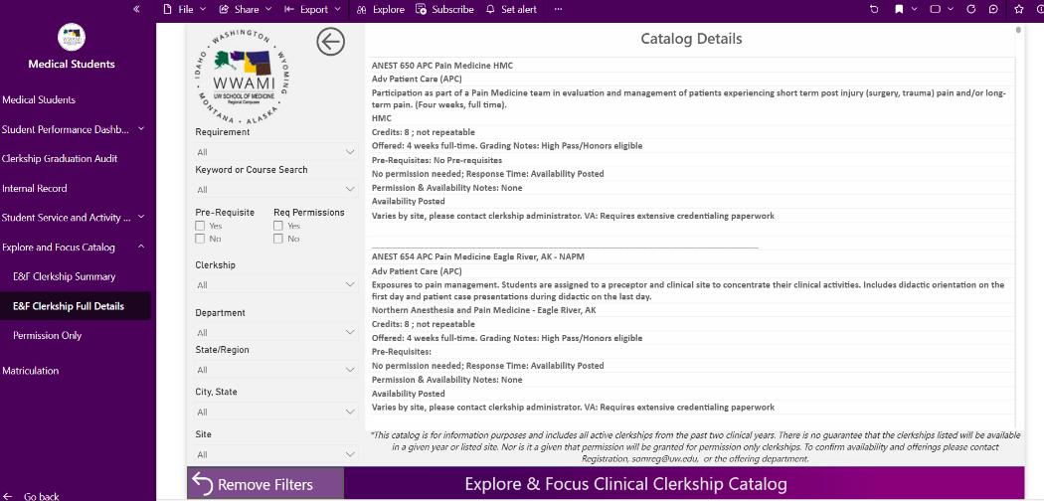
Appendix: Explore & Focus Catalog- DETAIL
DETAIL VIEW
GRADING INFO
PERMISSION, SCHEDULING, AVAILABILITY NOTES
CREDENTIALING INFO
PERMISSION CONTACT INFO

Slide 19
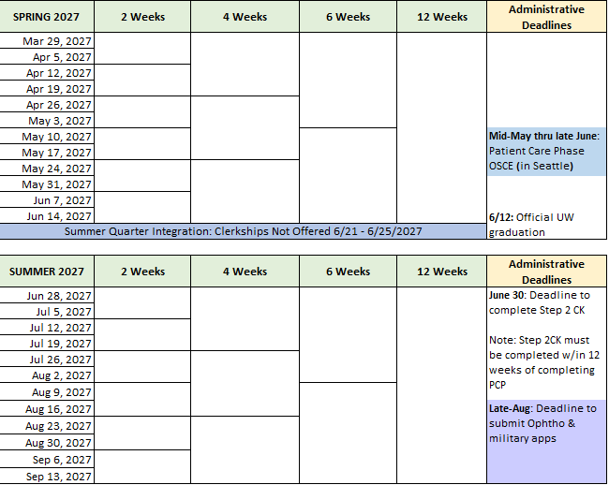

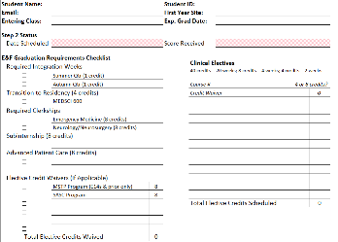
Helps you plan for Step 2 dedicated, order of rotations (for specialty choice, preparing for residency application, obtaining LORs, etc.), Away rotations, residency interviews, meeting graduation requirements
 | Appendix: Clinical Phase Planning Worksheet
education.uwmedicine.org/career-advising/resources/4th-year-planning/clinical-phase-planning-worksheet

Slide 20
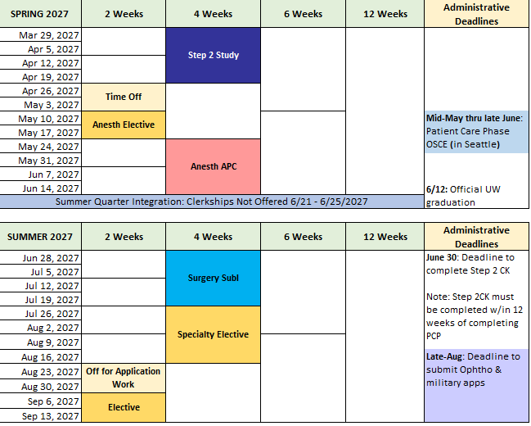
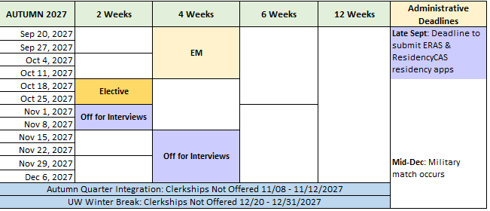
Student Considering Anesthesiology & General Surgery: Spring-Autumn Quarters
Example Clinical Phase Planning Worksheet
Prioritizes specialty rotations in Spring - Summer B
Ensures Letters of Recommendation in each specialty
2-4 weeks off to work on residency application
6-8 weeks off for interviews; no rotations

