Slide 1

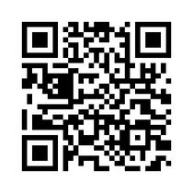

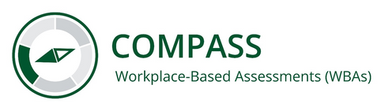
Workplace-Based Assessments (WBAs)
Beginning in Spring 2026, all three required Explore & Focus core clerkships (Neurology, Neurological Surgery, and Emergency Medicine), have additional WBA requirements.
How to Complete
WBAs are submitted though a Qualtrics survey. Each student has a unique form link and QR code that can be used by either the student or a preceptor to submit a WBA.
Required Activities:
  Gather a history
  Perform a physical examination
  Prioritize a differential diagnosis following a clinical encounter
  Recommend diagnostic or screening plans for common situations
  Interpret diagnostic or screening information for common situations
  Provide an oral presentation of a clinical encounter
  Document a clinical encounter
  Communicate with patients and/or families
WBA Requirements
For 4-week clerkships: At least 2 WBAs per week and at least 1 assessment for each of the 8 required activities.
Grading Bonus
A bonus of up to 2% to the final clinical grade is available for completing WBA requirements (not to exceed 100%).
  1% of the bonus is for completing at least two WBAs per week
  1% of the bonus is for completing the required number of each required activity over the course of the clerkship
An OR-specific activity – Prepare effectively for operative cases – is available to students taking Neurological Surgery. Completion of this activity counts towards the weekly WBA total but does not count as a required activity.
Learn More
Look for the COMPASS icon to identify UWSOM’s new assessment program!
Scan or click the QR code for more information about WBAs and changes coming in 2026-2027.

