Slide 1

Away Rotations
2025 - 2026
REGISTRATION
ːːːːːːːːːːːːːːː
Clinical Curriculum
ːːːːːːːːːːːːːːːː
Notes:
Debbie Introduces everyone

Slide 2
Presentation Overview
  Away Rotation Basics*
  Away Process: Applying For & Receiving Credit
  Q&A
Away Rotation = Away Elective = Away = Visiting Elective = Visiting Rotation
Notes:
Being recorded and will send it out
Feel free to add more in the chat and we hope to get to it at the end; if not send out a Q&A with answers afterwards.
Debbie

Slide 3
I. Away Rotation Basics

Slide 4
Away Basics
Clinical course at a site not affiliated with UWSOM
  Most are 4 weeks long
  Usually offered at teaching hospitals that are either AAMC-member institution or have at least one Accreditation Council for Graduate Medical Education (ACGME) or American Osteopathic Association (AOA) accredited program.
Purpose
  Increase your competitiveness for residency applications
  Residency “audition”
  Provides training in and exposure to environments outside UWSOM
  Personal (e.g., geography)
Notes:
-
Debbie

Slide 5
Away Basics
Not required to graduate
May count as an elective toward graduation requirements
Notes:
Debbie

Slide 6
MED EM
NEURL/
NEUR S
APC-S (Sub-I)
APC
Electives
UWSOM Electives
Away Electives
Within WWAMI (699)
Outside of WWAMI (697)
VSLO
Non-VSLO
Transition to Residency
EXPLORE & FOCUS PHASE
40 credits
(20 weeks)
Away rotations CANNOT count for
these
Notes:
Debbie
- There are two types of “away rotation” electives = 697 and 699. These numbers are associated with a department in which you are you taking your away rotation (i.e. PEDS 697)
- Most away rotations are 697
- Most host institutions use VSLO but there are exceptions: e.g. Stanford uses its own application system

Slide 7
Should You Take an Away?
Answer depends on
  Your desired specialty: Some specialties recommend Aways
  Your level of certainty about that specialty
  Personal factors
Help in deciding
  Review UWSOM Specialty Guides for specialties that recommend Aways (e.g., highly competitive specialties) (Tip: Very important!)
  Your career advisor
  Your specialty advisor
Notes:
Debbie

Slide 8
General Timeline
Winter Quarter | Receive VSLO invitation Prepare application materials
Early March | Most program catalogs open (some may open earlier)
April/May | Peak application time
Summer Quarter – Early Autumn Quarter | Most Aways taken during this time
IMPORTANT!
Aways must take place within a single SOM Clinical Quarter and cannot overlap with breaks or extend into another quarter. Exceptions can be made on a case-by-case basis for 697 aways at another LCME-accredited institution. All Special Assignment Electives must begin on a Monday and end on a Friday.
Notes:
Debbie

Slide 9
II. Away Process:
Applying For & Receiving Credit
Notes:
Debbie introduces Iryna

Slide 10
II. Away Process: Summary
BIG STEP 1: Apply to the host institution & be accepted
    Most host institutions use AAMC Visiting Student Learning Opportunities (VSLO)
    If not using VSLO: Go to the institution’s website, research visiting elective opportunities, and find application instructions (e.g., Google “Stanford School of Medicine visiting students”)
BIG STEP 2: Apply to the UW SOM department to be approved to receive clinical elective credit as a Special Assignment Elective.
BIG STEP 3: Schedule with UW SOM Registration
Notes:
Debbie
Stanford doesn’t use VSLO

Slide 11
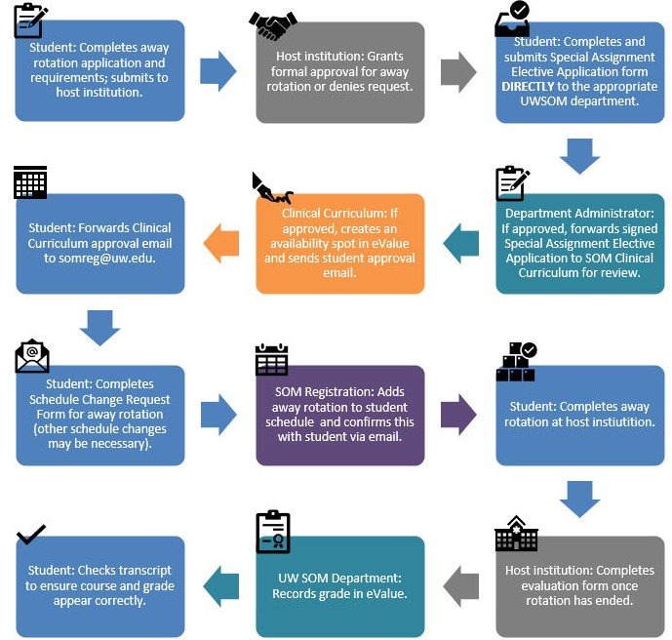
SUMMARY OF AWAY PROCESS
AKA: HOW TO GET CREDIT FOR AN AWAY ELECTIVE
Notes:
Debbie

Slide 12
BIG STEP 1: Applying to a Host Institution
Notes:
Debbie

Slide 13
VSLO: First Things First
Activate your invitation from VSLO
  Expires after 28 days (somreg@uw.edu if expired)
Find Participating Institutions
Find Electives
Learn how to use VSLO
  How to Use VSLO
  VSLO Tutorials
  VSLO Essentials
Notes:
Debbie

Slide 14
VSLO: Your To-Do List
Complete application & profile
Upload:
  Professional photo
  CV
  Personal Statement or Letter of Intent
  Immunization Forms from Health Sciences Immunization Program myshots@uw.edu
  Compliance requirements UWSOM Compliance
    Background check, drug screen, OSHA/Universal Precautions, HIPAA
  USMLE exam score report
Notes:
Iryna

Slide 15
VSLO: Your To-Do List
Have your official UW transcript sent to us to upload
    Check your unofficial transcript FIRST, then order at UW Registrar
    Request an official third-party PDF transcript be delivered to us:
    1. Click "I'm sending to myself or another individual"
    2. Select the icon for "Electronic: Delivered by Email"
    3. Enter recipient information as follows:
    >>>> UWSOM
    >>>> somreg@uw.edu
    DO NOT request a paper/hard-copy transcript
Need an updated transcript uploaded to VSLO? Same process as above.
Notes:
Iryna
Individual hosts may require updated transcript – pay attention to whether they want it sent directly to them or uploaded to VSLO

Slide 16
VSLO: SOM Reg To-Do-List
Verify: Good academic standing, OSHA training, BLS training, mask fit testing, medical liability & malpractice insurance, HIPAA training, expected graduation date, passing score on USMLE Step 1, required core clerkship dates.
Upload:
  Letters of good standing (if needed)
  Letters of recommendation (if needed – release required)
  Official UW transcript
Notes:
Iryna
We can not verify a student until they have submitted at least one application

Slide 17
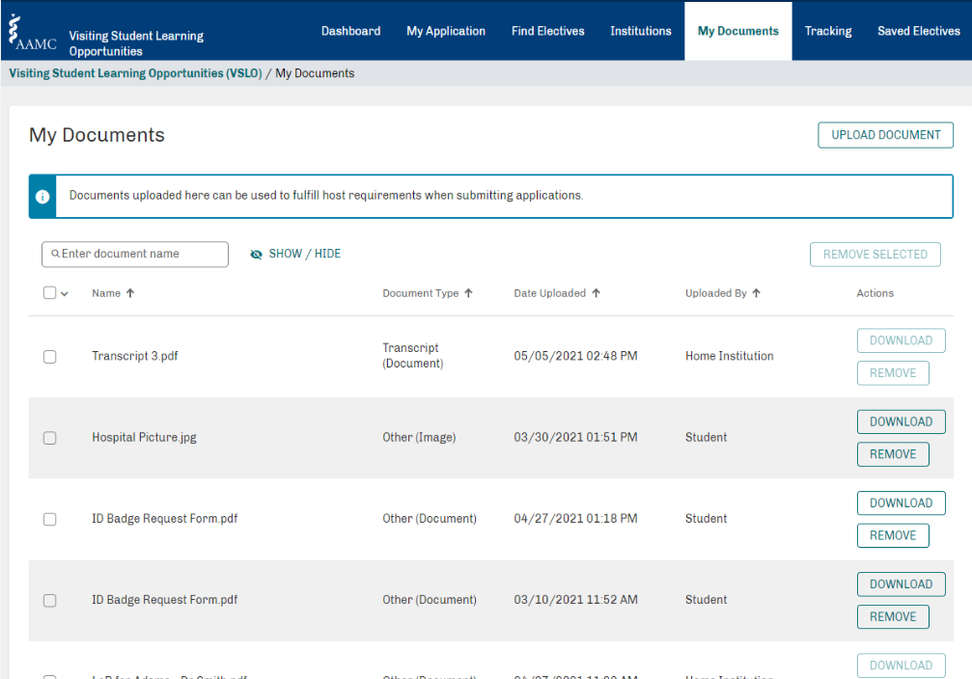
Has UW SOM Registration uploaded my ____yet? Check here.
Notes:
Iryna
You can not remove documents we upload
You can not view documents we upload (i.e. transcripts and LOR)
Make sure to name anything you upload so it’s easy to know what it is (eg ‘myform’ not helpful; “Blackstone Duke Ortho Personal Statement” is better)

Slide 18
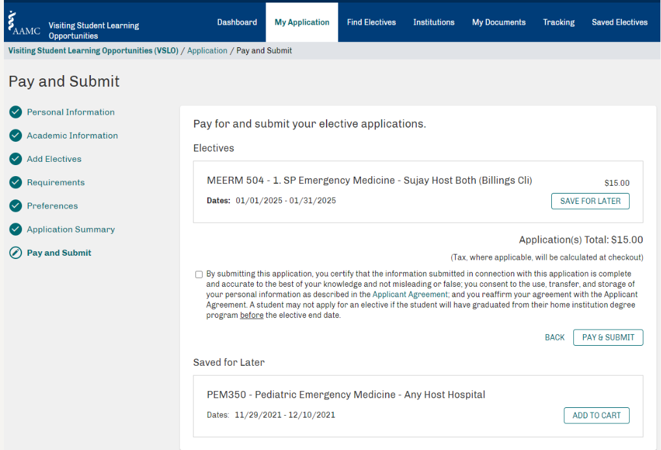
Also on Your To-Do List
Notes:
Iryna
If you don’t submit it you haven’t applied for it.
Contact Diane Noecker FA assistance for away rotation costs

Slide 19
Waiting for Responses
Response time depends on host
    May be notified months or weeks in advance
Remember SOM Six-Week Deadline
    Late Drop Permission isn’t guaranteed
    Contact the Clinical Departments for permission
    Extenuating circumstances: Dr. Maya Sardesai
Notes:
Iryna

Slide 20
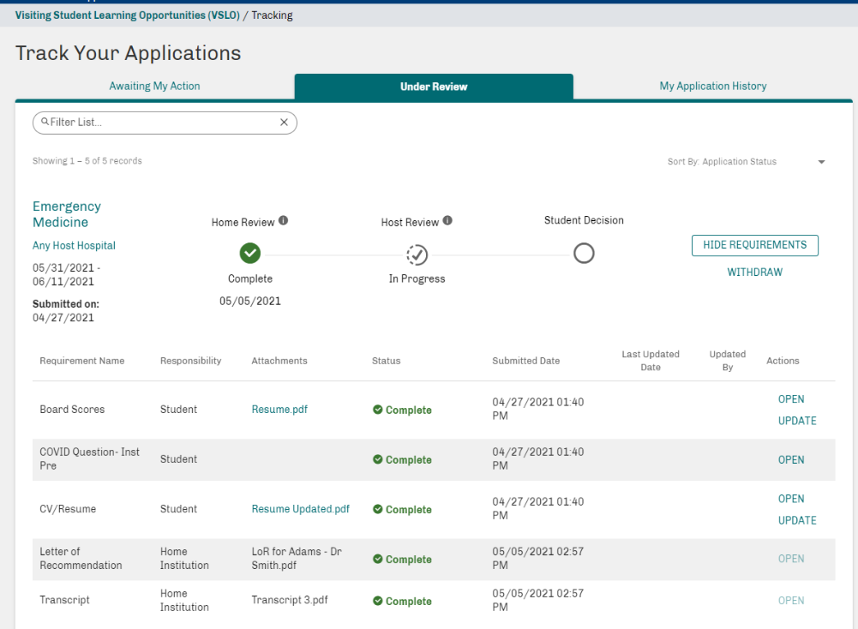
Notes:
Iryna
Home institution needs to release applications

Slide 21
Accepting and Declining Offers
Accept or decline the offer via VSLO or institution’s application system
If accepted, fulfill any post-decision requirements for conditional offers and submit for a final host institutional review
Don’t forget to withdraw applications in VSLO
Already accepted an offer and want to withdraw?
    Consult Career Advisors
    Contact Host Program
Notes:
Iryna
Note about Post decision requirements

Slide 22
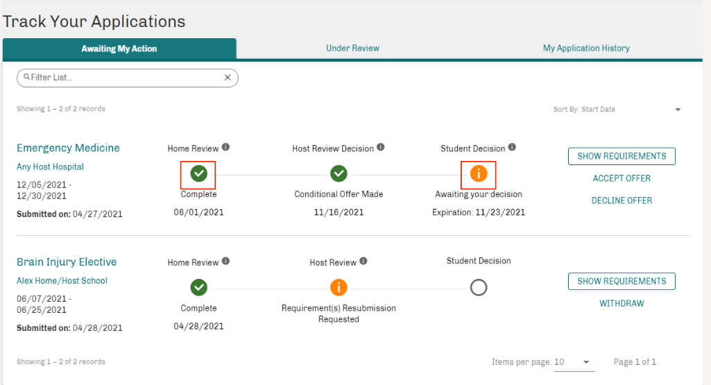
Withdrawing from Away Rotations
Notes:
Iryna
Withdrawing and declining offers are a normal part of this process.
Key BE PROFESSIONAL! Decline offers no less than 6-8 weeks from the start of the rotation as a professional couresty. Declining an offer will not impact on residency opportunities if handled professionally with plenty of notice.

Slide 23
BIG STEP 2:
Applying to receive UW SOM Credit aka, Special Assignment Electives
Notes:
Debbie introduces Meghan Filer

Slide 24
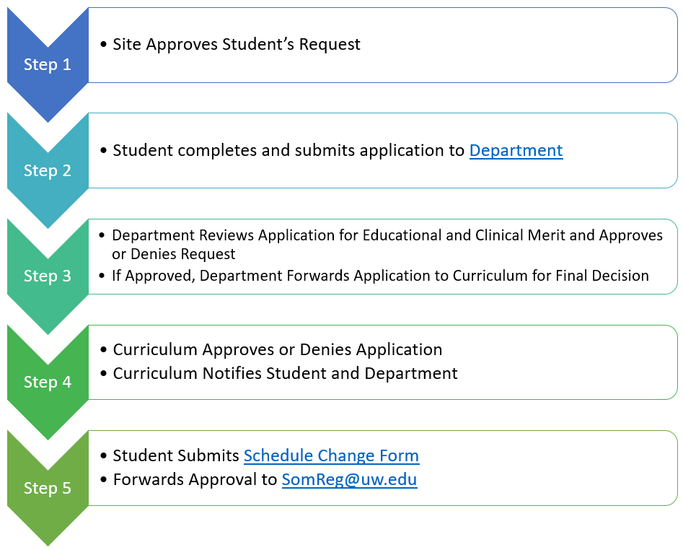
Special Assignment Electives:
Receiving UW Credit – 697 (non WWAMI rotations)
Students that want clinical elective credit for an away rotation must complete and submit a Special Assignment Elective application for approval.
Students work with Department Admins corresponding with the elective; application submitted to Department.
Department reviews/approves, then forwards to SOM Curriculum
Curriculum reviews/approves, then sends email with next steps (registration)
Notes:
Meghan Filer - curriculum

Slide 25
Special Assignment Electives:
Receiving UW Credit – 699 (within WWAMI)
Students work with providers at hospitals & clinics to set up one-off clinical experience within the WWAMI region (not done through VSLO)
Process and application mostly the same as 697 process
  Additional approval required- Regional Clinical Dean’s Office (except Seattle area)
Electives at non-LCME accredited institutions or non-ACGME accredited residency programs are permissible within the WWAMI region and require additional application information. Instructions are listed on at the top of the application and on our website.
Clerkship must follow clerkship dates on UW SOM Clinical Calendar
Notes:
Meghan Filer - curriculum

Slide 26
Special Assignment Electives - NOTES
Please note the following:
  Students cannot retroactively apply for SOM credit for their away rotations. Rotations must be approved and on the student’s SOM schedule prior to the start date.
  Special Assignment Electives only count towards clinical elective credit.
  Application processing times may vary - can be up to 2 weeks for typical application. If a site is non-LCME or non-ACGME accredited it can take up to 2 months for approval. The earlier we get your applications the better!
  WEBSITE: https://education.uwmedicine.org/curriculum/by-phase/clinical/explore-and-focus/special-assignment-electives/
  QUESTIONS: medevalu@uw.edu
Notes:
Meghan Filer - Curriculum

Slide 27
BIG STEP 3:
Getting an Away Course on Your Schedule for Credit
Notes:
Debbie

Slide 28
To Add an Away Rotation to Your Schedule:
Forward Clinical Curriculum’s approval of Special Assignment elective to somreg@uw.edu
Submit an Add request in the eValue Manage Schedule Request tool. Ensure you attach your permission email from medevalu@uw.edu as a PDF to your Add request.
YOU MUST DO BOTH OF THE ABOVE !
SOM Registration will make the schedule change in eValue and confirm with you when that’s been done.
Remember to get department approval for courses added or dropped within 6 weeks of a course start date
Notes:
Debbie

Slide 29
Process Pitfalls
You accepted away elective from host institution | You applied to the UW SOM Department for approval | You forwarded approval email from Clinical Curriculum to somreg@uw.edu | You submitted a Clinical Schedule Change Form to somreg | You receive credit toward an elective for graduation
Yes | No | No | No | No
Yes | Yes | No | No | No
Yes | Yes | Yes | No | No
Yes | Yes | Yes | Yes | Yes!
Notes:
Debbie

Slide 30
Getting Credit
UW SOM Home Department will provide an evaluation form
Host institution will complete evaluation form and send back to UW home department.
UW Clinical Department records final grade in eValue
Notes:
Debbie

Slide 31

Q & A: Questions?
Scheduling & Application Logistics: somreg@uw.edu
Special Assignment Electives: medevalu@uw.edu
Advising:
Career Advisors: Sarah Thomson, Tonja Brown & Linh Ngo medadv@uw.edu
Specialty Career Advisors
Notes:
Debbie

