Slide 1
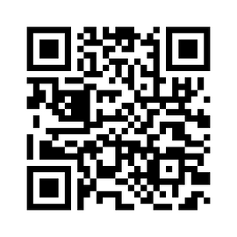


Workplace-Based Assessment (WBA) Pilot
Beginning in Spring 2025, all six required Patient Care core clerkships (Family Medicine, Internal Medicine, Psychiatry, Obstetrics & Gynecology, Surgery, and Pediatrics), including WRITE clerkships, have additional WBA requirements.
How to Complete
WBAs are submitted though a Qualtrics survey. Each student has a unique form link and QR code that can be used by either the student or a preceptor to submit a WBA.
Required Activities:
  Gather a history
  Perform a physical examination
  Prioritize a differential diagnosis following a clinical encounter
  Recommend appropriate diagnostic and screening tests
  Interpret common diagnostic and screening tests
  Provide an oral presentation of a clinical encounter
WBA Requirements
For 3-week and 6-week clerkships: At least two WBAs per week and at least one assessment for each of the six required activities.
For 12-week clerkships: At least two WBAs per week and at least two assessments for each of the six required activities.
Grading Bonus
Completion of new WBA requirements will add a bonus of up to 2% to the final clinical grade (not to exceed 100%), as follows:
For each WBA submitted (up to a maximum of up to 2/week) students will earn 1/6 of 1% for 3-week clerkships, 1/12 of 1% for 6-week clerkships, or 1/24 of 1% for 12-week clerkships.
For each activity submitted, students will earn 1/6 of 1% for 3-week and 6-week clerkships (up to a maximum of 1/activity) or 1/12 of 1% for 12-week clerkships (up to a maximum of 2/activity).
Learn More
Scan or click the QR code for more information about the WBA pilot and planned changes coming in 2026-2027.

