Slide 1
Personal Accountability Data Stewardship 2019
Sheila Green-Shook
UW Medicine Compliance

Slide 2
Agenda
Defining data stewardship and your responsibilities
Safeguarding confidential information
DOs and DON’Ts
Current security threats
Tools and resources

Slide 3
What is Data Stewardship?
Every individual is personally and professionally responsible for the security and integrity of the confidential information (electronic, paper or verbal) entrusted to you.
UW Medicine Professionalism Policy: Demonstrated excellence, integrity, respect, compassion, accountability and a commitment to altruism in all our work interactions and responsibilities.

Slide 4
Protection of data required by law includes:
Protected health information (PHI)
Personally identifiable information (PII)
Financial information (credit card, SSN, DOL)
Protected under HIPAA & RCW (including breach notification)
Protected under HIPAA & RCW
Employee Information
(personal contact info, performance evaluations)
Individual student records
Protected under
FERPA
PHI, PII, Employee Information, Student Records
Protected under RCW (including breach notification)
Different Types of Data

Slide 5
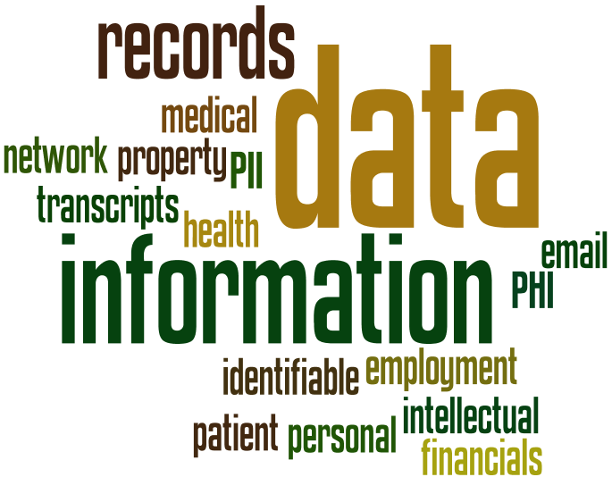
What this Means
The goal – maintain the privacy and security of the information
It is your personal, professional and ethical responsibility to protect the information used in the course of your work for UW Medicine, keeping it safe and secure and protecting it from loss and theft.

Slide 6
Securing Confidential Information
“Breach” for purposes of HIPAA occurs when there is an unauthorized acquisition, access, use or disclosure of unsecured PHI
Breach requires notification
Two ways to secure PHI
Encryption
Confidential Destruction

Slide 7
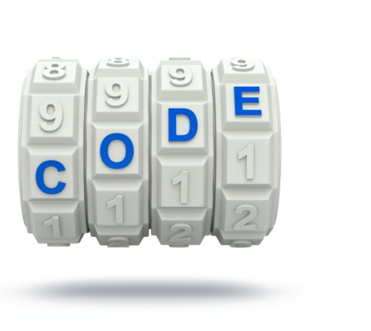
Encryption (Mobile Devices)
Encryption is required to protect information from unauthorized access & to mitigate disclosure requirements.
Mobile devices are high risk because they are easily lost or stolen.
Encrypt devices containing PHI, PII or other confidential information
Do not enable automatic login
Use strong passwords & change passwords often
UW Medicine provides encryption guidance for:
Emails
Mobile Devices
Files

Slide 8

Destruction
Remove data prior to disposal, recycling,
or reassignment of electronic devices
(e.g., fax machine, biomedical device,
desktop computer, or mobile device)
Deleted files and emails may still exist on your device until you empty the trash bin – so, empty your electronic trash bin regularly

Slide 9
Why Is This Important to Me?
Possible consequences of lost confidential information that has not been secured
Personal and professional
time
name known
reputation and relationship with patients
imposition of disciplinary action
civil/criminal penalties
Institutional
report to the Office of Civil Rights
notification to patients
imposition of fines and sanctions
costs of investigation and remediation
impact to UW Medicine reputation

Slide 10


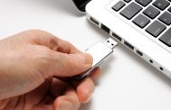
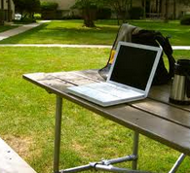
What you can do
Encrypt and password to protect data
Do not save to an unencrypted mobile device
Use encrypted email or send through an approved email domain
Do not open an email or attachment from an unknown source
Obtain approval to take PHI offsite and do not leave unattended
Report all possible breaches
When taking information offsite…secure it and keep it in your possession at all times

Slide 11
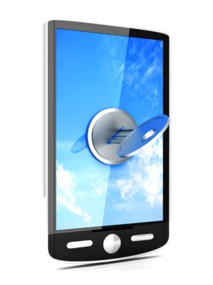
DO
If you use a mobile device
to store or transmit PHI or PII, your mobile device
MUST be encrypted!

Slide 12
DON’T
NEVER leave confidential data in your car!
Protect yourself against theft – nobody thinks they will be a victim!

Slide 13
EXAMPLES – UNSECURED PHI
Rounding/Handoff Report found by water park
9 patients - name, date of birth, diagnoses
Hand-written Assessment and Plan
Sent to UW Medicine Compliance from individual who found the report
Provider calling patients in a busy airport waiting area
Provider asked for patients by name
Shared specific test results overheard by others
Information reported through anonymous hotline
Transmit QI data to an unauthorized server at academic institution
Student transmitted to a secure file server which had been used before
Professor reported and compliance completed an investigation

Slide 14
Current Security Threats

Slide 15
Phishing
Designed to trick a person into giving up:
personal and professional credentials
account information
other identity information to access your personal or professional information and systems
steal or damage data

Slide 16

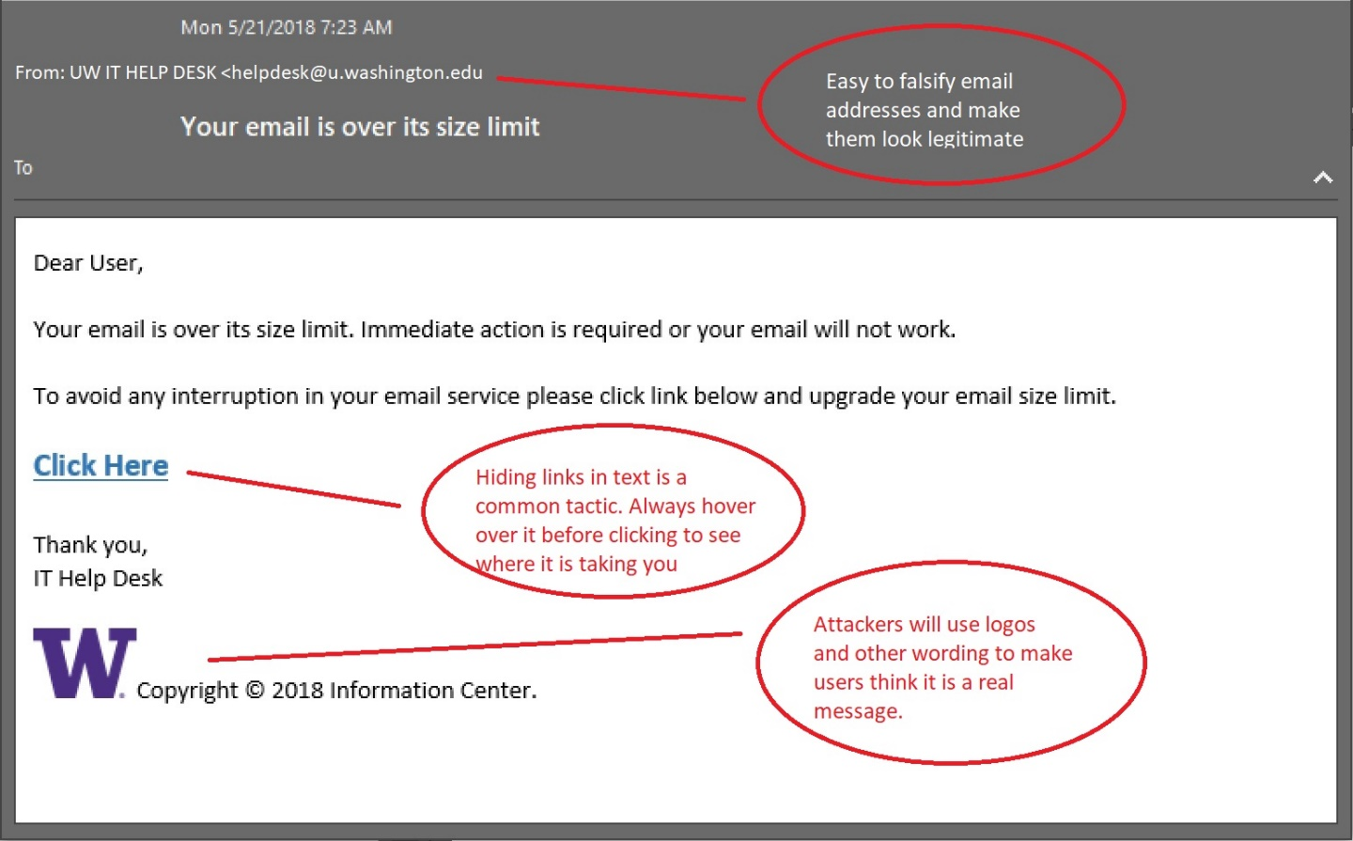
Phishing Example
Report suspicious e-mails:
Uwmed-abuse@uw.edu
HOVER DON’T CLICK

Slide 17
Phishing @ UW
UW/UW Medicine will never ask for account information via email
UW Medicine periodically sends phishing messages to our workforce to help raise awareness – includes training
YOU WILL RECEIVE PHISHING MESSAGES – be very wary and very cautious!

Slide 18

Malware
Ransomware
Crypto-mining
Spyware
Botnet
Many more…

Slide 19
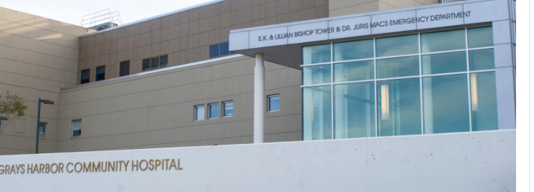
Recent ransomware attack
Discovered by hospital personnel on June 15th, 2019
85,000 patients potentially impacted
Not all encrypted data has been recovered
Offered one year free credit monitoring to affected patients
Reinforced education/training for staff in avoiding e-mail phishing schemes
Report to OCR

Slide 20

Protect Yourself
Don’t click on links and don’t open attachments from unknown or unexpected sources

Slide 21
Smartphone/Tablet Security
If you use a smartphone or tablet to conduct UW business, such as accessing your UW email:
Auto lock device and use a strong password
Enable encryption on the device
Set an automatic lockout timer on the device
Enable Erase data to erase all data after 10 failed passcode attempts
Enable “find my phone” function
Don’t use cloud back up services, such as iCloud or Google Drive, unless it is an approved cloud by UW Medicine IT Security for PHI or FERPA data
Don’t store data on the SIM card

Slide 22


Incident Reporting
If you get infected, or think you may be infected, contact DOM IT at domhelp@uw.edu
Report information security incidents when they occur to DOM IT
Report the loss or theft of PHI to UW Medicine Compliance at 206.543.3098 or comply@uw.edu

Slide 23
TOOLS and RESOURCES

Slide 24
Tools to Assist You in Safeguarding Data
Creating strong passwords
https://depts.washington.edu/uwmedsec/restricted/accounts-and-passwords/
How to encrypt
https://depts.washington.edu/uwmedsec/restricted/guidance/encryption/
Securing your physical space
Contact your building facilities department
Education and training materials https://depts.washington.edu/uwmedsec/restricted/training/
UW Medicine Privacy, Confidentiality and Information Security Agreement (PCISA)
http://depts.washington.edu/comply/docs/002_F1.pdf

Slide 25
Cloud Resources
One Drive for Business (formerly UW SkyDrive Pro)
requires UW NetID
https://depts.washington.edu/uwsom/information-technology/skydrivepro
http://www.washington.edu/itconnect/wares/online-storage/onedrive/

Slide 26
Phishing Resources
Educational Tools
UW Medicine IT Security Phishing and Spam Email Guidance: https://depts.washington.edu/uwmedsec/restricted/guidance/phishing-and-spam-email-guidance/
Office of the Chief Information Security Officer phishing video: https://ciso.uw.edu/education/online-training/#phishing

Slide 27
Other Resources
Office of the Chief Information Security Officer
http://ciso.washington.edu/
UW Medicine IT Security (requires UW NetID)
https://depts.washington.edu/uwmedsec/restricted/about-its-security/
UW Medicine Professionalism Policy
http://uwmedicine.washington.edu/Global/policies/Pages/Professional-Conduct.aspx

Slide 28
Contact Information
Dean of Medicine IT: domhelp@uw.edu; 206.221.2459
SoM Academic and Learning Technologies: somalt@uw.edu
UW Medicine IT Services Help Desk: mcsos@u.washington.edu
UW Medicine Compliance: comply@uw.edu; 206.543.3098
Center for Shared Services IT: csshelp@uw.edu; 206.543.9413

