Slide 1
History, Constructs, and Assumptions: The Potential Bias of Race in Medical Care
Edwin Lindo, JD
Dept. of Family Medicine
University of Washington School of Medicine
*Statements are my own.

Slide 2
Disclosures
Still waiting…

Slide 3
What We WIll Cover:
- Understanding Race -
- History of Racialized Medicine -
- Contemporary Racialized Medicine -
- How Do We Get Better? -

Slide 4
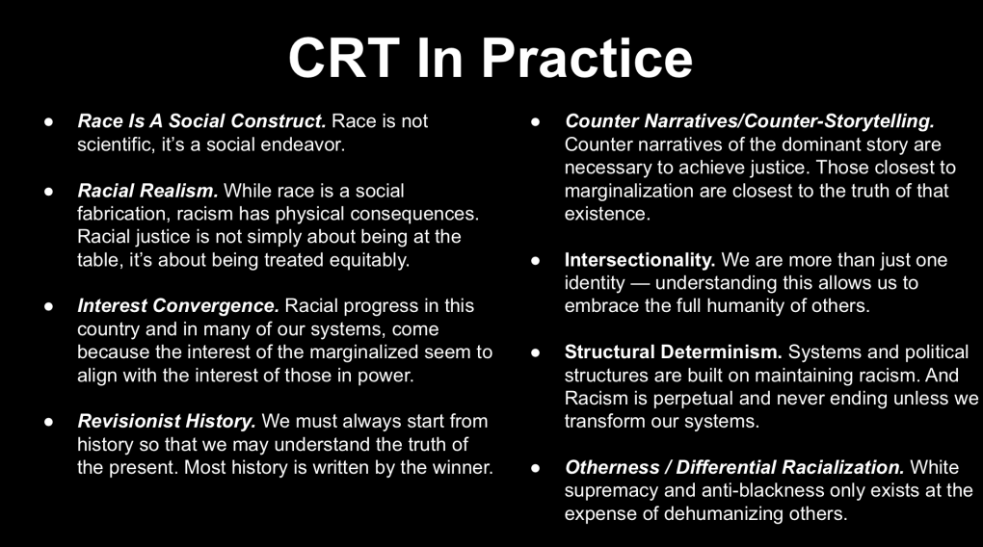

Slide 5
Defining Race

Slide 6
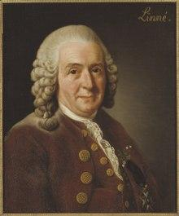
Carl Linnaeus (1707-1778), a Swedish physician, botanist, and zoologist, was a celebrated researcher in biologically defining human race. In Systema Naturae (1767), he labeled five “varieties” of human species. Each one was described as possessing the following physiognomies characteristics “varying by culture and place”:
The Americanus: red, choleraic, righteous; black, straight, thick hair; stubborn, zealous, free; painting himself with red lines, and regulated by customs.
The Europeans: white, sanguine, browny; with abundant, long hair; blue eyes; gentle, acute, inventive; covered with close vestments; and governed by laws.
The Asiaticus: yellow, melancholic, stiff; black hair, dark eyes; severe, haughty, greedy; covered with loose clothing and ruled by opinions.
The Afer or Africanus: black, phlegmatic, relaxed; black, frizzled hair; silky skin, flat nose, tumid lips; females without shame; mammary glands give milk abundantly; craftily, sly, lazy, cunning, lustful, careless; anoints himself with grease; and governed by caprice.

Slide 7
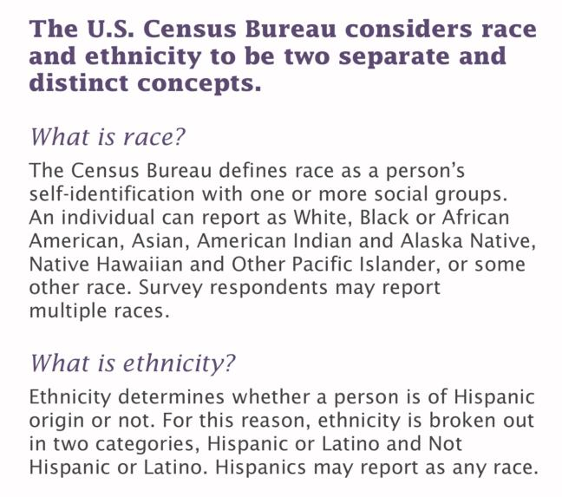
In 1779, Johann Blumenbach, a German scientist, doctor, physiologist and anthropologist was the first to utilize the term “race” as we have come to understand it today. He argued that it was not four species we should be identifying, but rather, five “races” by hierarchy:
Caucasian or “white” race;
Mongolian or “yellow-brown” race;
Ethiopian or “black” race;
American or “copper-red” race;
Malayan or “black-brown” race;
A class or breed of animals; a group of individuals having certain characteristics in common, owing to a common inheritance.
Source: Miller-Keane Encyclopedia and Dictionary of Medicine, Nursing, and Allied Health, Seventh Edition
A group of people identified as distinct from other groups because of supposed physical or genetic traits shared by the group. Most biologists and anthropologists do not recognize race as a biologically valid classification, in part because there is more genetic variation within groups than between them.
Source: The American Heritage® Medical Dictionary
1. a vague unscientific term for a group of genetically related people who share certain physical characteristics.
2. a distinct ethnic group characterized by traits that are transmitted through their offspring.
Source: Mosby's Medical Dictionary, 9th edition.
Race is a social construction, a concept that has no objective reality but rather is what people decide it is Source: (Berger & Luckmann, 1963).
A socially constructed taxonomy based on perceived skin color (and sometimes culture), with no scientific or biological determinacy. Source: Edwin Lindo, 2019

Slide 8
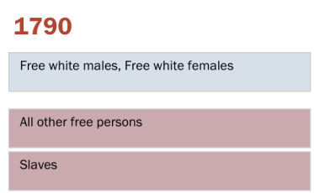
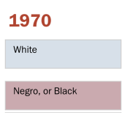
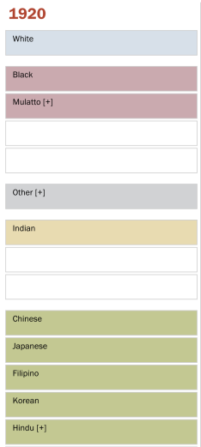
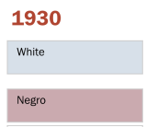
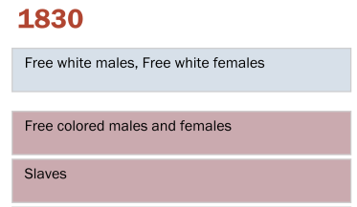
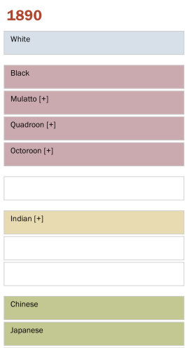
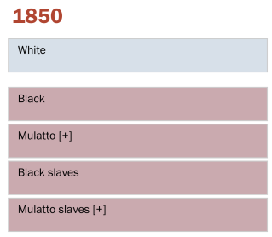
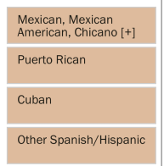
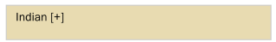


Definitions varied from census to census, but Mulatto generally meant someone who is black and at least one other race
Added in 1860.
Added in 1880.

Slide 9
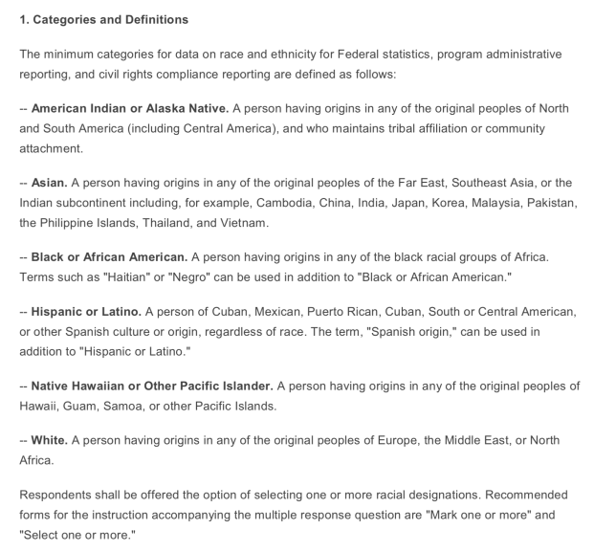


Slide 10
RACE IN
RESEARCH

Slide 11
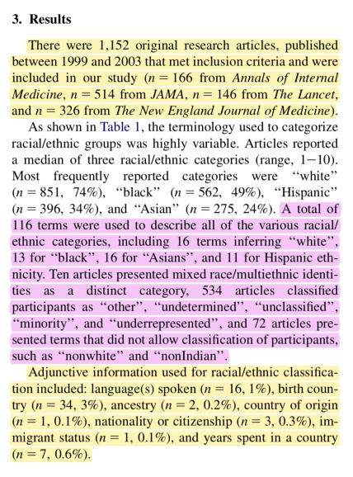
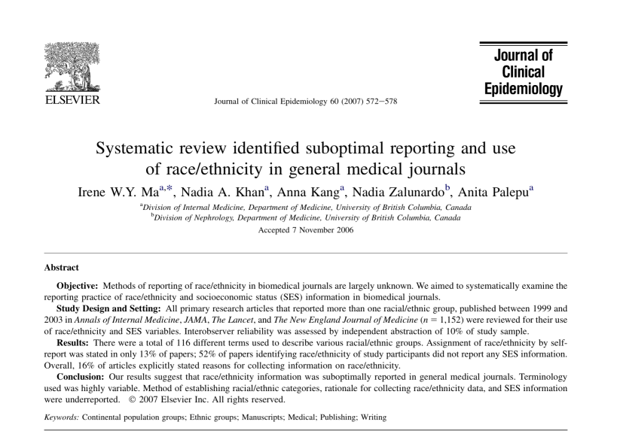
RACE IN
RESEARCH

Slide 12
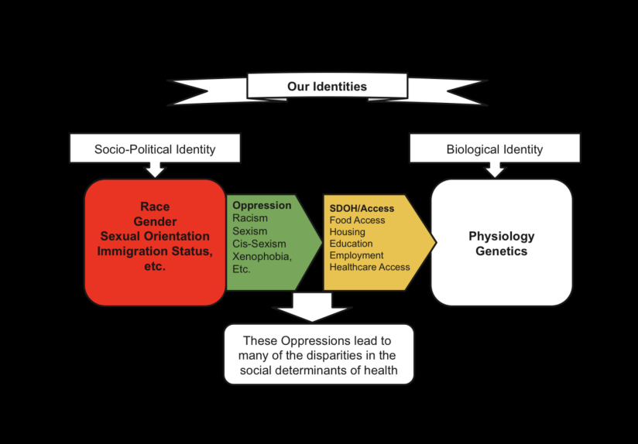
Our Identities
Socio-Political Identity
Biological Identity
Race
Gender
Sexual Orientation
Immigration Status
Soci-economic
Physiology
Genetics
Racism
Sexism
Cis-Sexism
Xenophobia
Poverty, etc.
These Oppressions lead to many of the disparities in the social determinants of health

Slide 13
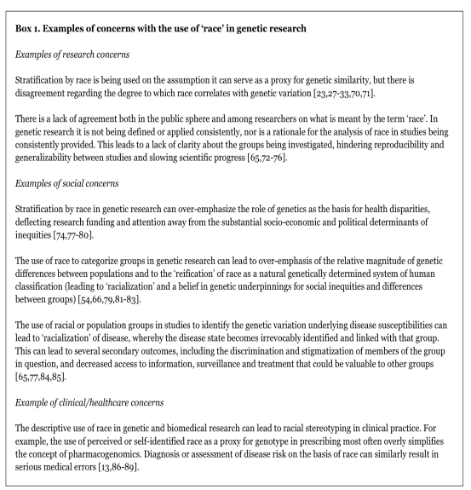
Concerns with use in Genetic Research
Research Concerns
1. Using race as genetic proxy. There is disagreement regarding the degree to which race correlates with genetic variation. [More contemporary work has shown that Race is not an effective proxy for genetic variation.
2. There is no clear definition of ’race‘. The application of any definition is too variable.
Social Concerns
1. Stratification by race in genetic research can over-emphasize the role of genetics as the basis for health disparities, deflecting research funding and attention away from the socio-political determinants of inequities.
2. Can lead to the ‘racialization’ of disease, i.e., Pathologizing Race.
Clinical/Healthcare Concerns
1. Can lead to racial stereotyping, which can over simplify the concept of pharmacogenomics. Diagnosis or assessment of disease risk based on race can similarly result in serious medical errors.
Caulfield T, Fullerton S, Ali-Khan S, Arbour L, Burchard E, et. al., Race and Ancestry in Biomedical Research: Exploring the Challenges. 2009

Slide 14
Recommendations on How Best To Use Race In Research
Study design
1. Endeavor to measure relevant social, economic, environmental, biological or genetic factors directly rather than using race or ethnicity as proxies.
2. Use race/ethnicity (and gender and socio-economic status) only when data relevant to the underlying social mechanisms have been collected and included in the analysis. Attempt to measure as many alternative variables as possible. These may include, but should not be limited to: racism and discrimination, socio-economic status, social class, personal or family wealth, environmental exposures, insurance status, age, diet and nutrition, health beliefs and practices, education level, language spoken, religion, tribal affiliation and country of birth.
3. Use terms that are as descriptive as possible, rather than catch-all terms in common use, and use terms that reflect how groups were demarcated.
4. When populations are compared, use groupings that are precisely defined and of similar resolution.
5. When possible, use terminology and naming for groups that are acceptable to the groups themselves.
6. Ensure that assignment of subjects to research categories is appropriate to the research question being asked.
Caulfield T, Fullerton S, Ali-Khan S, Arbour L, Burchard E, et. al., Race and Ancestry in Biomedical Research: Exploring the Challenges. 2009

Slide 15
Study Reporting
1. Define the variables being used.
2. Justify the relevance of the variables used to the research hypothesis.
3. Explain precisely how the data were collected, such as whether the data were self-reported or assigned by others or, if it was by survey, what terms were included in the forms or other materials.
4. Describe and justify the categories used to group populations.
5. Consider conferring with the community from which participants were drawn to verify that results are presented in a manner acceptable to them.
6. Consider carefully the implied relationship between study populations and the populations to which findings are generalized.
7. Consider carefully the social and ethical implications of the study results.
8. Prepare a lay summary of the study conclusions, taking care to use accurate terminology, for use in communicating to the popular press.
9. Be prepared to follow up and set the record straight if study results are misinterpreted.
Recommendations on How Best To Use Race In Research, Cont’d
Caulfield T, Fullerton S, Ali-Khan S, Arbour L, Burchard E, et. al., Race and Ancestry in Biomedical Research: Exploring the Challenges. 2009

Slide 16
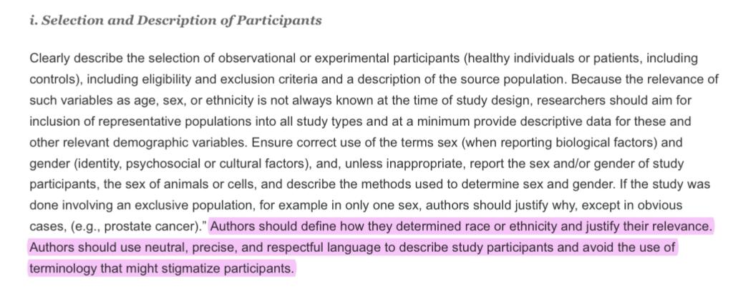
International Committee Of Medical Journals Editors

Slide 17
Pathologizing Race

Slide 18
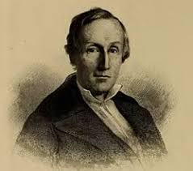
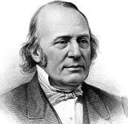
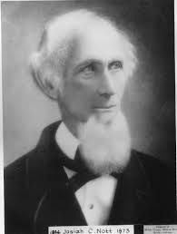
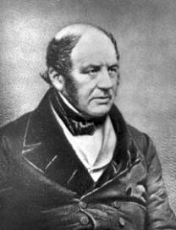
Physiognomy
Polygenism
Dr. Samuel Morton
Dr. Louis Agassiz
Craniology
Race & Species
Phrenology
Dr. Josiah Nott
Dr. Samuel A. Cartwright
Notes:
Dr. Johann Blumenbach (Classification Based on Cranium - Craniology)
Dr. Samuel A. Cartwright (1796-1863) (Drapetomania)
Samuel Morton, MD (1799 - 1851)
Physician / Professor of Medicine at Pennsylvania College of Medicine; Books: Crania Americana (1839), Crania Aegyptiaca (1844))
Louis Agassiz, MD (1807-1873)
Physician / Celebrated Harvard Professor 1847-1873
Dr. Josiah Nott
Dr. Glidden

Slide 19
Samuel A. Cartwright, MD (1793 - 1863)
Physician: Psychiatrist/Surgeon
Attended Univ. Of Pennsylvania School of Medicine
Studied and was apprentice to Dr. Benjamin Rush
Publications: Report On The Diseases And Physical Peculiarities Of the Negro Race (1851)
Created the pseudo-Disease, Drapetomania: “The [psychological] disease causing negroes to run away.” “If the white man attempts to oppose the Deity’s will, by trying to make the negro anything else than ‘the submissive knee-bender,’ the negro will run away.” Prescription: “Whipping them out of it.” (Source: “Report on The Diseases And Physical Peculiarities of the Negro Race” 1851)
Created a second pseudo-disease, Dysaethesia Aethiopica, aka “Rascality”: “From the careless movements of the individuals affected with the complaint, they are apt to do much mischief, which appears as if intentional, but is mostly owing to the stupidness of mind and insensibility of the nerves induced by the disease."
(Source: “Report on The Diseases And Physical Peculiarities of the Negro Race” 1851)

Slide 20
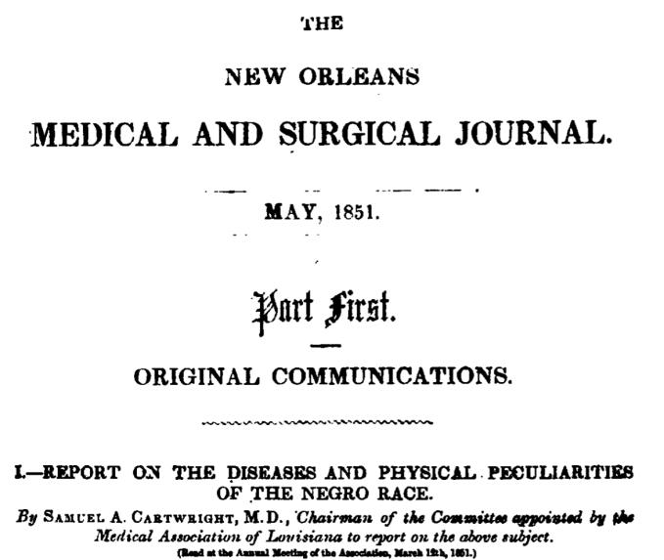
Notes:
“Anatomy and physiology have been interrogated, and the response is, that [Negroes are] unfitted, because of his organization and the physiological laws predicated on that organization, for the responsible duties of a free man, but, like the child, is only fitted for a state of dependence and subordination.”

Slide 21
Samuel Morton, MD (1799 - 1851)
Physician / Professor of Medicine at Pennsylvania College of Medicine
Books: Crania Americana (1839), Crania Aegyptiaca (1844)
Caucasians: Are "distinguished by the facility with which it attains the highest intellectual endowments";
Native Americans: Are "averse to cultivation, and slow in acquiring knowledge; restless, revengeful, and fond of war, and wholly destitute of maritime adventure"
African (Black People): “The Negro joyous, flexible, and indolent; while the many nations which compose this race present a singular diversity of intellectual character, of which the far extreme is the lowest grade of humanity."
Notes:
Samuel Morton, at least in the United States, was very much influenced by his racial dispositions and perceived hierarchy, using his science to reinforce and support the necessity of chattel slavery of black bodies.
His theories resonated with pro-slavery whites in the United States. “In fact, upon Morton’s death in 1851, the Charleston Medical Journal published a memoir stating: “We can only say that we of the South should consider him as our benefactor, for aiding most materially in giving to the negro his true position as an inferior race.”

Slide 22
History:
The study of measuring how much we’ve truly transformed, or how much we’ve maintained the same.
Notes:
There are a number of quotes pertaining to history, but none that captured the necessity of knowing history. Many speak to knowing history to prevent the mistakes of the past, but that approach suggests that the tactics and ways of the past don’t currently exist.
We can’t speak of progress because the progress suggested in the context of history, that we’ve moved away from the outright domination of other humans based on the idea of superiority. But there can be no ‘progress’ from complete dehumanization and still falling short of full due respect as human.

Slide 23
Contemporary Racialized Medicine
Notes:
Speak on Bidil;
Anasthesia of blacks
Pain among people of color
Racialized Pharmaceuticals and racial genetic therapies.

Slide 24
Is Race Genetic?
''Race is a social concept, not a scientific one,'' said Dr. J. Craig Venter, head of the Celera Genomics Corporation in Rockville, Md.
Notes:
There is no genetic marker for race.

Slide 25


Slide 26
The Case - BiDil
What is it?
Who is it for?
What does it claim?
BiDil is a single-pill, fixed-dose combination of two generic drugs, isosorbide dinitrate and hydralazine hydrochloride. The combination exerts vasodilatory effects on both arterial and venous vascular systems.
FDA Approved 2005.
BiDil is used with standard HF treatment, aimed at prolonging time to hospitalization, improving patient-reported functional status, and reducing all-cause mortality. (Bidil website)
BiDil is the only heart failure (HF) medicine specifically indicated for self-identified African American patients.(BiDil Website)

Slide 27
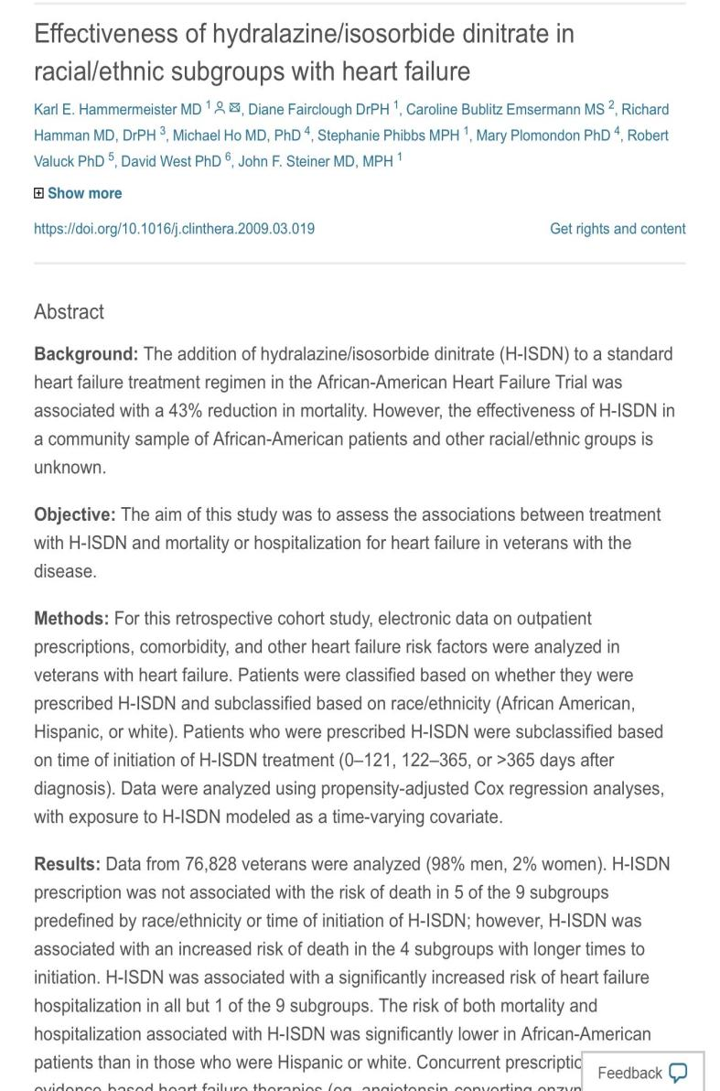
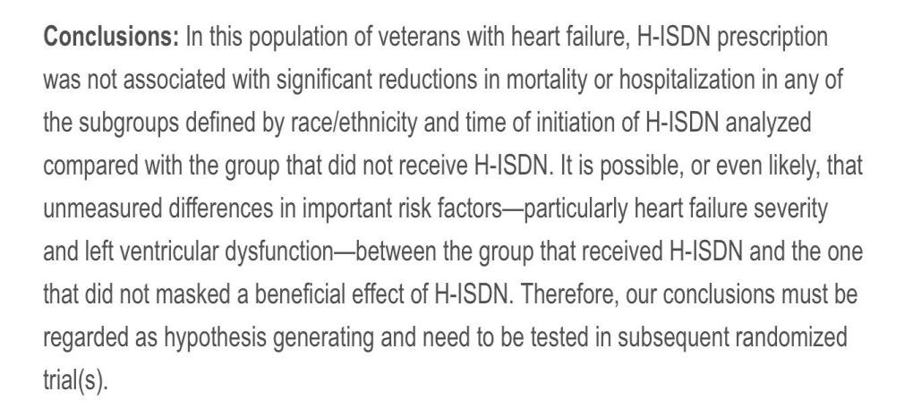
Notes:
Source: https://www.sciencedirect.com/science/article/abs/pii/S0149291809000940

Slide 28
Questions To Consider
What is Racialized Medicine?
Is there utility?
Is there harm?
Biological Determinancy
Racialized Medicine is the practice and belief by the scientific community that Race can serve as a biological marker to determine health outcomes.
Social Determinancy
Research and scholarship offers us the tools to find utility in using race in medicine to better contextualize social determinants of health, but that is the extent of it.
Pathologizing Race
Racialized medicine, in its biological determinant form, pathologizes race as the cause of diseases and fails to address the social determinants of health. This also stigmatizes and further marginalizes communities. It also moves further away from personalized care.
Notes:
In this slide we should talk about how a social construction, Race, was then grafted onto medical and physical science. This act alone is a confusing one that leads to many questions — unfortunately, however, medicine fails to stop and attempt to answer these questions. Questions such as, how do we define race? When is race useful in medicine? Can medicine truly address the medical needs of a patient by using a social construction as a proxy for medical science?
Discussion on harm of Racialized Medicine, we miss things:
"If you make clinical predictions based on somebody's race, you're going to be wrong a good chunk of the time," Yudell told Live Science. In the paper, he and his colleagues used the example of cystic fibrosis, which is underdiagnosed in people of African ancestry because it is thought of as a "white" disease.

Slide 29
What Other Examples Do we Have of Racialized Medicine?
ACE Inhibitors
Calcium Channel Blockers
The “African Gene” Theory/Middle Passage Hypertension Hypothesis
Renal Disease Equation: Glomeruler Filtration Rate (Measures Kidney Function
Pain Levels based on Race

Slide 30
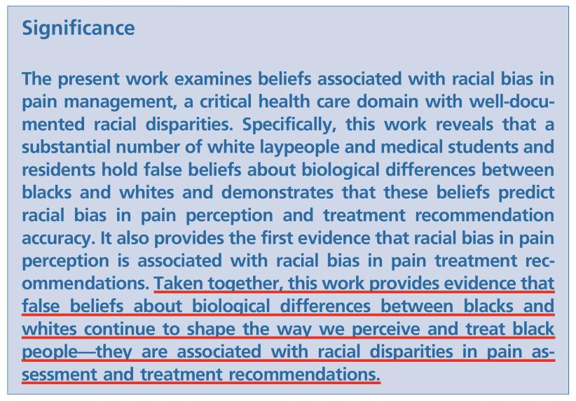
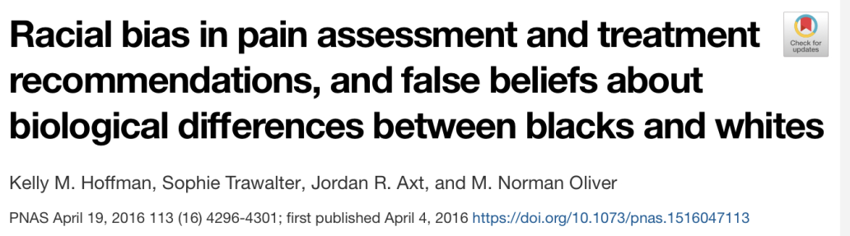
Samuel Cartwright, Again!

Slide 31
Samuel A. Cartwright, MD (1793 - 1863)
Physician: Psychiatrist/Surgeon
Attended Univ. Of Pennsylvania School of Medicine
Studied and was apprentice to Dr. Benjamin Rush
Publications: Report On The Diseases And Physical Peculiarities Of the Negro Race (1851)
Created the pseudo-Disease, Drapetomania: “The [psychological] disease causing negroes to run away.” “If the white man attempts to oppose the Deity’s will, by trying to make the negro anything else than ‘the submissive knee-bender,’ the negro will run away.” Prescription: “Whipping them out of it.” (Source: “Report on The Diseases And Physical Peculiarities of the Negro Race” 1851)
Created a second pseudo-disease, Dysaethesia Aethiopica, aka “Rascality”: “From the careless movements of the individuals affected with the complaint, they are apt to do much mischief, which appears as if intentional, but is mostly owing to the stupidness of mind and insensibility of the nerves induced by the disease."
(Source: “Report on The Diseases And Physical Peculiarities of the Negro Race” 1851)

Slide 32
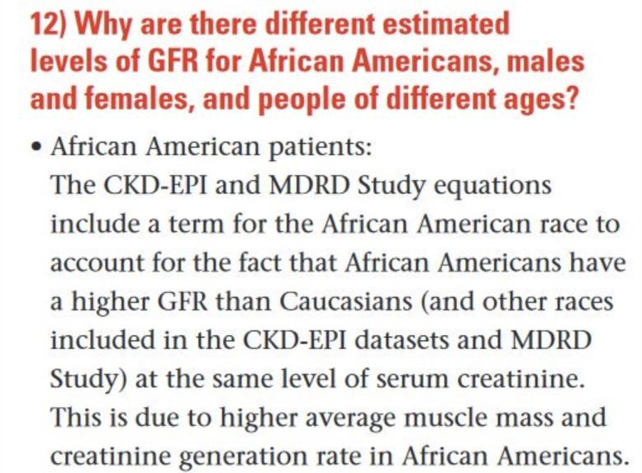

Slide 33
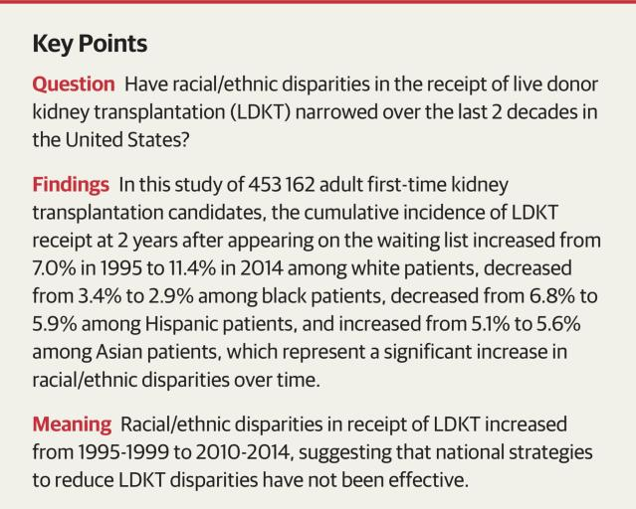
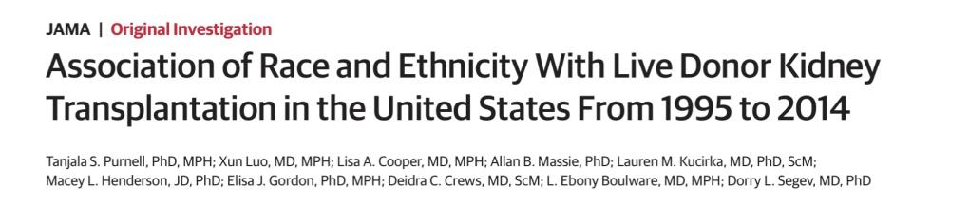
Notes:
Racial Realism: Though attitudes and words are important, racism is much more than having an unfavorable impression of members of other groups. For realists, racism is a means by which society allocates privilege and status. Racial hierarchies determine who gets tangible benefits, including the best jobs, the best schools, and invitations to parties in people’s homes.
Interest Convergence. Civil Rights and justice gains for communities of color coincide with benefit to white folks.
Revisionist History. Revisionist history reexamines America’s historical record, replacing comforting majoritarian interpretations of events with ones that square more accurately with minorities’ experiences. It also offers evidence, sometimes suppressed, in that very record, to support those new interpretations. Revisionism is often materialist in thrust, holding that to understand the zigs and zags of black, Latino, and Asian fortunes, one must look to things like profit, labor supply, international relations, and the interest of elite whites.
Critique of Liberalism/Color-blindness. Critical race scholars are discon- tent with liberalism as a framework for addressing America’s racial problems. Many liberals believe in color blindness and neutral principles of constitutional law.
“The white race deems itself to be the dominant race in this country. And so it is, in prestige, in achievements, in education, in wealth, and in power. . . . But in view of the constitution, in the eye of the law, there is in this country no superior, dominant, ruling class of citizens. There is no caste here. Our constitution is color-blind, and neither knows nor tolerates classes among citizens. In respect of civil rights, all citizens are equal before the law. The humblest is the peer of the most powerful.
Justice John Harlan, dissenting, in Plessy v. Ferguson, 163 U.S. 537 (1896).
Structural Determinism. Our society of systemic and institutional racism is self-propagating and will operate as it currently does until the systems change. That is, Racism is perpetual unless we transform the systems that uphold racism

Slide 34
The Data Of Health Disparities

Slide 35
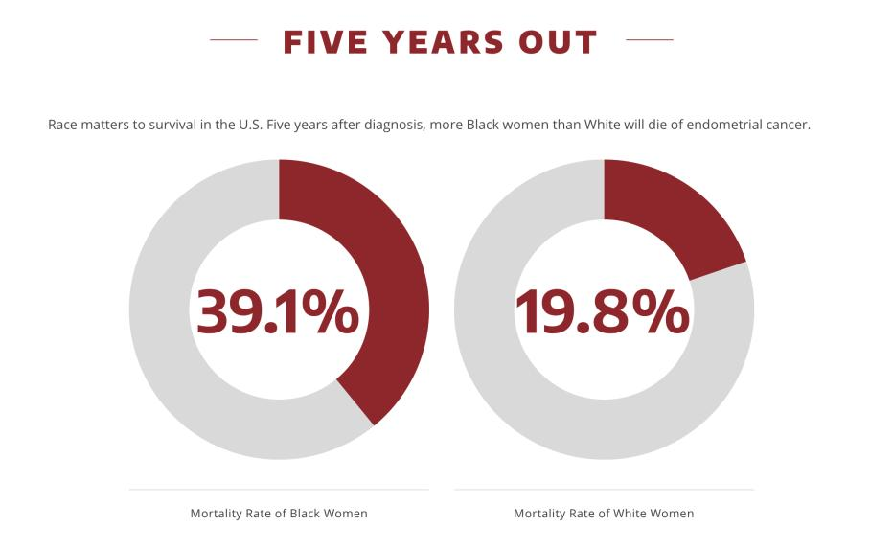
Notes:
Speak on Bidil;
Anasthesia of blacks
Pain among people of color
Racialized Pharmaceuticals and racial genetic therapies.

Slide 36
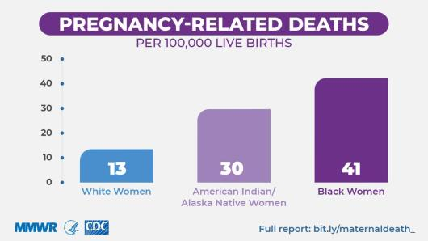
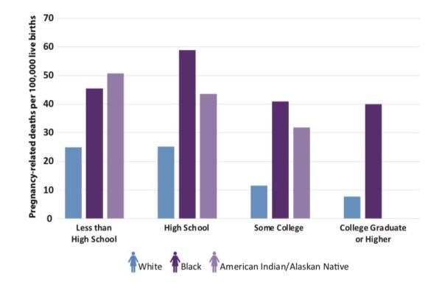
Notes:
Speak on Bidil;
Anasthesia of blacks
Pain among people of color
Racialized Pharmaceuticals and racial genetic therapies.

Slide 37
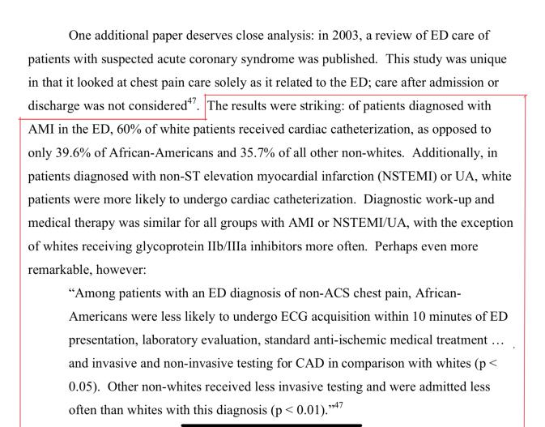
Video: https://www.facebook.com/NowThisNews/videos/1988265154538298?sfns=mo
Racial and Ethnic Disparities in the Emergencty Department: A Public Health Perspective, Heron MD, MPH, S., Stettner MD, E., Haley, Jr. MD MHSA, L.
Notes:
Speak on Bidil;
Anasthesia of blacks
Pain among people of color
Racialized Pharmaceuticals and racial genetic therapies.

Slide 38
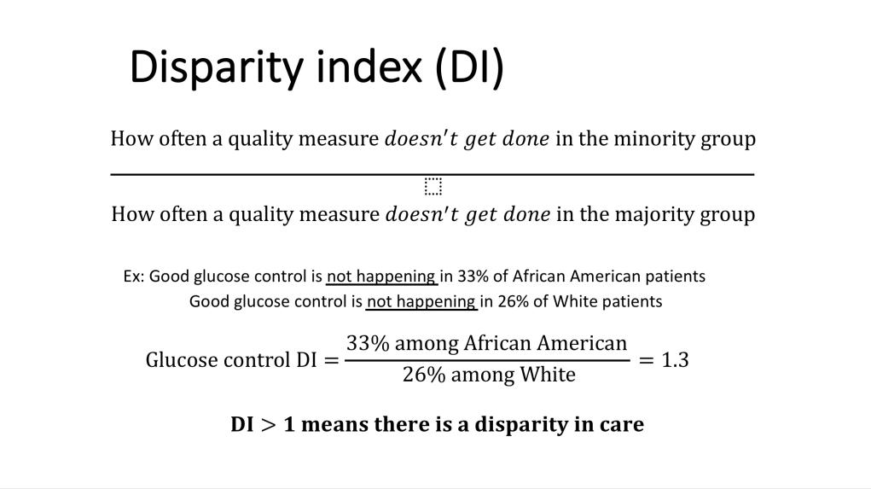
Notes:
Speak on Bidil;
Anasthesia of blacks
Pain among people of color
Racialized Pharmaceuticals and racial genetic therapies.

Slide 39
Notes:
Speak on Bidil;
Anasthesia of blacks
Pain among people of color
Racialized Pharmaceuticals and racial genetic therapies.

Slide 40
The Skeptics

Slide 41
Questions on Dr. Goldfarb’ s Opinion Piece:
1. What’s his main concern?
2. What assumptions are carried throughout the piece?
3. Where should Medical Education be heading?
4. Other thoughts?
Notes:
Speak on Bidil;
Anasthesia of blacks
Pain among people of color
Racialized Pharmaceuticals and racial genetic therapies.

Slide 42
CASE
- 46 year old man brought to HMC ER by medics as an auto vs bicycle. The patient was unhelmeted and riding when he was struck by an automobile at approximately 30-40mph.
- In the field, the patient was noted to have a lower extremity abnormality with fullness in his thigh and complaining of significant leg pain concerning for long bone fracture. He was described as combative and received two large bore IVs, c-collar, placed in full spine precautions on a back board and was administered ketamine due to assumption of illicit drug abuse as the cause of his combativeness.
- Upon presentation to HMC the patient was agitated and full trauma activation and evaluation was performed. The patient’s wife arrived and was brought into the room by social work but not introduced to the team. After a few minutes, the wife was eventually identified was able to confirm no prior medical history or illicit drug use history.
- The ER trauma team concluded their evaluation and determined that after speaking with the patient he was experiencing hallucinations given he is naive to illicit drugs and was having an adversarial reaction to the ketamine administered in the field. An x-Ray obtained in the trauma bay confirmed femur fracture and pain was likely the cause of the patient’s perceived combativeness in the field.
-Given the mechanism significant enough to cause long bone fracture the determination was made that the patient would need CT pan-scan. However, given his agitation and hallucination the ER trauma team concluded the patient would need additional doses of ketamine to get him through the CT and then all further doses would be discontinued and he would be allowed to metabolize the medication out of his system.
Notes:
Speak on Bidil;
Anasthesia of blacks
Pain among people of color
Racialized Pharmaceuticals and racial genetic therapies.

Slide 43
How Do We Get Better?
- When we hear race used as a biological determinant, we must ask WHY?
- Question Our “Objectivity”
- Let’s be humble enough to change our “objectivity.”
- Embrace that racial health care disparities exist, but it’s not because of a person’s race, it’s because of how we (society & the medical field) treat people of marginalized identities.
-Dedicate time to learning more about Race and Racism. The more we understand, the better we become at providing for patients.
Notes:
Speak on Bidil;
Anasthesia of blacks
Pain among people of color
Racialized Pharmaceuticals and racial genetic therapies.

Slide 44
Questions?
Please feel free to contact me:
Edwin Lindo
eglindo@uw.edu
Tweet me: @edwinlindo
Notes:
Speak on Bidil;
Anasthesia of blacks
Pain among people of color
Racialized Pharmaceuticals and racial genetic therapies.

