Slide 1
WRITE in 2020-2021
38 students
35 sites
Regional breakdown
13 Montana students
4 Wyoming students
8 Idaho students
11 Washington students
7 Eastern Washington
4 Western Washington
2 Alaska students
Othello, WA

Slide 2
2019 WRITE Excellence in Teaching Nominees
Jonathan Currey, MD
Catherine Doyle, MD
Jill Dudik-Bross, MD
Sue Gallo, MD
KayCee Gardner, MD
Burke Hansen, MD
Julie Lyons, MD
Ashley Quanbeck, MD
Terry Smith, Do
Bob Urata, MD
Kelly Walker, MD

Slide 3
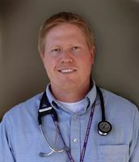
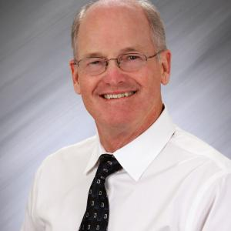
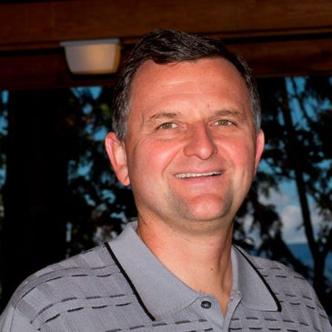
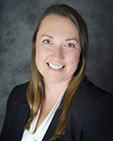
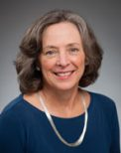
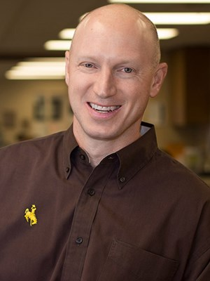
2019 WRITE Excellence in Teaching Award Winners
Alaska
Andrew Sanders, MD
Eastern Washington
Dennis Kearns, MD
Idaho
Dan Meulenberg, MD
Montana
Laura Twist, MD
Western Washington
Sarah Heiner, MD
Wyoming
Patrick Yost, MD

