Slide 1
The Education Process: Teaching and Remediation
Heidi Combs MD, MS
Associate Professor, University of Washington,
Department of Psychiatry and Behavior Sciences
Jesse Markman MD, MBA
Assistant Professor, University of Washington,
Department of Psychiatry and Behavior Sciences

Slide 2
Objectives: At the end of this talk the participant will be able to:
Determine if a learner exhibits a problematic pattern of behavior that warrants remediation.
Diagnose the deficit domain: knowledge, skill, or attitude
Jointly formulate a remediation plan with the learner
Create a schedule for follow up to assess effectiveness of the remediation plan

Slide 3
Outline of session
Group discussion regarding their session goals
Review groups remediation experiences- successes and failures
Review of teaching framework
Review of remediation framework
Pair work on a case of their own or a case provided
Report out on pair activities
Wrap up

Slide 4
Notes:
Danielle invited Jesse and I to spent time with you all talking about learner remediation- what were you hoping to get out of this session?

Slide 5
Your remediation stories
Good?
Bad?
Ugly?
Notes:
Examples of cases of remediation that were successful? Any that were not?
Describe the situation, but not all the underlying causes, contributing factors, and/or the outcome- you will get to do that later!

Slide 6
A quick review: How To Teach

Slide 7
Key Steps to Teaching Effectively
Expectations
Engagement
Feedback
Follow-up
Assessment

Slide 8
Expectations

Slide 9
Expectations
Expectations are the basis of performance
No one likes to not know what they should be doing
Set expectations at the beginning of the rotation and refresh them often
If the expectations are not known by the learner, feedback will feel unsubstantiated

Slide 10
Expectations are the basis of performance
High Expectations
Beget High Performance
Low Expectations
Beget Low Performance

Slide 11
Engagement

Slide 12
Experienced based learning gives the best retention
Recall requires experience:
And Practice
 | Told | Told and Shown | Told, Shown, Experienced
Recall (3 weeks) | 70% | 72% | 85%
Recall (3 months) | 10% | 32% | 65%
Whitmore, J. (2009). Coaching for Performance. London: Nicholas Brealey Publishing.

Slide 13
Create An Enabling Environment
Learners Will Learn And Function Best When…
Learners have compelling direction
Learners have an enabling structure
Learners have a supportive context
Learners have expert coaching
Hackman, J. Leading Teams. 2002. Harvard Business School Publishing Co. Boston.
Dutton, J. Energize Your Workplace. 2003. John Wiley & Sons, Inc. Hoboken, NJ.
Notes:
Set expectations
Allow autonomy and ownership
Recognize and reinforce

Slide 14
Matching learner states to teaching styles
 |  | Teacher styles
 |  | Authoritative | Motivator/ facilitator | Delegator
 | Dependent learner | Match | Resident will get mired in the details | Resident will feel lost
Learner stages | Interested learner | Resident will not self elevate to self direction | Match | Resident will not feel supported
 | Self-directed learner | Resident feels micromanaged | Resident will not benefit from the motivation of ownership of tasks | Match
Grow. G. Teaching learners to be self directed. Adult Educ Q 1991;41:125-129

Slide 15
Matching learner states to teaching styles
As a learner progresses there is often a shift from dependent → to interested→ to self-directed
Too much of a mismatch can be defeating but a degree of mismatch can be positive.

Slide 16
Assessment

Slide 17
Assessment
Helps the teacher know where the learner is at and what the learner needs so teaching styles can be adjusted
Helps the teacher determine what sort of deficits are present so appropriate feedback can be given
Notes:
jesse

Slide 18
Assessments flow from expectations
Set expectations at the beginning of the night and refresh them often
If the expectations are not known by the learner, the feedback based on the assessment will feel unsubstantiated
Assess multiple events
Everyone has good and bad moments – recognize patterns
Write down notes of what you thought at the time

Slide 19
Challenges with assessments
We tend not to distinguish between items- if a learner performs well in one area we tend to assess them well in other areas (halo effect)
Personality traits (e.g. extroversion, introversion) may have a positive or negative impact on our assessment
Turnbull J., Van Barneveld C. Assessment of clinical performance: in-training assessment. In: Normal GR, van der Vleutem CPM, Newble DI editors. International handbook of research in medical education. Dordrecht, Netherlands:Kluwer Academic Publishers, 2002;793-810

Slide 20
Feedback

Slide 21
What Is Feedback?
Feedback is the constructive and objective appraisal of performance given to improve skill
Formative feedback:
An appraisal of the skills demonstrated in the here and now
Purpose: Improving specific skills
Feedback should be specific, objective, and direct
Summative feedback:
A general appraisal of overarching skills and abilities
Purpose: Assessing competency, document achievement
Feedback is more general, but should have specific situations and occurrences which support both positive assessments and areas for suggested improvement
Bienstock, J. et. al. To the point: medical education reviews – providing feedback. American Journal of Obstetrics & Gynecology 2007;508-513.

Slide 22
Feedback flows from assessment
Feedback is the opportunity to turn an assessment into a vehicle for growth for the learner
Assessment is the opportunity to consider the stage and progress of the learner. It flows naturally once expectations are set

Slide 23
Why Is Feedback Important?
Feedback is essential to accurate self appraisal of skills and improvement on skills
Without feedback, alternative feedback is created by the learner and other assessments are overvalued
Memory is valued over clinical skill
Physicians significantly overvalue their current skill level and give poor self assessments
Without feedback, no one gets any better
Bing-You, R., Trowbridge, R. Why Medical Educators May Be Failing at Feedback. JAMA 2009;302:12:1330-1331.

Slide 24
Giving Feedback
Ask for self assessment
Ask the learner what went well
Ask the learner what could be improved
Give your assessment
Describe what you noticed that went well
Reinforcing positives is just as important as identifying areas for improvement
Describe things you think could be improved
Couch this in the experience of the learner to demonstrate the value to the learner
Make sure to allow the learner to comment on the feedback
If the learner does not buy into the feedback provided, they will not hear what you have said and are less likely to apply the information
Make an action plan
Bienstock, J. et. al. To the point: medical education reviews – providing feedback. American Journal of Obstetrics & Gynecology 2007;508-513.

Slide 25
Giving feedback
Be fair
Be specific
Be consistent
Be constructive
Be timely
Be flexible
Be open
Be collaborative
Do it in an appropriate setting
Psychiatric Residents As Teachers: A Practical Guide Second Revision Committee on Graduate Medical Education 2001-2002

Slide 26
When to defer
When strong emotions are involved
When you are hearing about something secondhand and have not yet had an opportunity to investigate

Slide 27
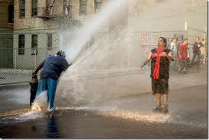
Change your mindset about feedback
Feedback often should take less than 5 minutes!!
It is more valuable to give feedback snippets along the way!
It is not helpful to hose them down at the end!

Slide 28
When the going gets rough

Slide 29
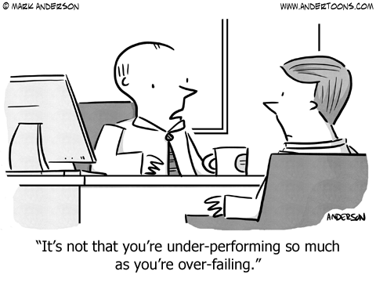

Slide 30
Remediation

Slide 31
Steps in Remediation
Step 1: Determine if remediation is needed
Step 2: Diagnose the deficit domain(s)
Step 3: Jointly build a remediation plan
Step 4: Set your plan for follow-up

Slide 32
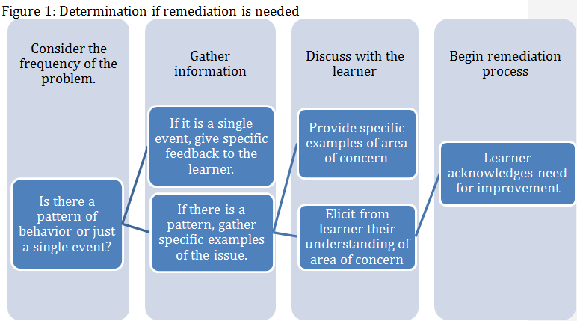
Step 1: Determine if there is a problem
Notes:
Determine this through information gathering:
Is this a pattern?
Assess multiple events over time
Problematic patterns that persist despite feedback
Gather specific examples
This is not stylistic difference, personality, learning/teaching styles
Contextual features

Slide 33
Yes Houston, There is a problem: Now what?

Slide 34
Step 2:Identify domain deficit
Knowledge
Skills
Attitude

Slide 35
Knowledge
If a learner doesn’t know what is going on or what he or she should be doing, it’s hard to get it right
You may find yourself surprised that a learner is unaware, but this may be reality
If these deficits are present, it may indicate a need to :
Assess your own orientation and what is being retained
Set more specific expectations and assess for understanding expectations
Notes:
There’s setting expectations and then there’s setting expectations

Slide 36
Skills
If a learner doesn’t know how to do what he or she should be doing, it’s hard to get it right
Learner skill sets vary considerably
Rotations vary
The level of exposure at different sites varies
Learners vary in their ability to acquire new skills
The presence of skill in one area does not necessarily translate to another area/skill/situation

Slide 37
Stages In Acquiring Skills
Awareness
Consciously Incompetent
Consciously Competent
Unconsciously Competent
Unconsciously Incompetent
Learning
Practice

Slide 38
Attitude
The learner knows what to do and how to do it, but chooses not to
Most difficult area for most people to address
Assessment starts with understanding where your learner is coming from
Notes:
How do you determine where the learner is coming from/?

Slide 39
Learner
Do you remember what it was like to be a medical student… or resident?
Where are they coming from?

Slide 40
Supplemental Assessment
Sometimes the issue is actually more about our own interaction or experience of the learner than the learner
“it’s not you it’s me… no really...”
Part of the assessment also needs to consider yourself with the learner
How is this making you feel?
What is bothering you about this?
What do you want or need?

Slide 41
Supplemental Assessment
Sometimes students are irritating or annoying
What is annoying you?
What is annoying about the thing that is annoying you?
Is this objectively irritating?
It is entirely appropriate to conclude that the student needs to annoy you less to be successful, but you want to be clear that this is part of the equation

Slide 42
Remediation Plan
Step 1: Determine if remediation is needed
Step 2: Identify the deficit(s) domain
Step 3: Build a remediation plan
Step 4: Set your plan for follow-up

Slide 43
Key Remediation Plan Features
Dependent on deficit
Created collaboratively with learner and supervisor
Delineation of clear expectations (for all parties):
What needs to change and how will it be assessed/measured?
Create timeline
Notes:
Teach back is critical here! We are uncomfortable so we want to quickly get though this and get out of the room! Make sure the learner repeats to you what the expectations are including what needs to change, how it will be measured and what the time line is. Also what the consequences of failure are

Slide 44
Remediation Plan
Step 1: Determine if remediation is needed
Step 2: Identify the deficit(s)
Step 3: Build a remediation plan
Step 4: Follow-up based on plan!

Slide 45
Step 4: Set your plan for follow-up
How will you know if this plan is successful?
When will you follow-up with the learner?
Having a plan for follow-up and measurement of success helps all sides see growth and progress
Validates the learner
Allows the teacher to adjust aspects if needed
Without follow-up, your plan will lose momentum quickly and easily

Slide 46
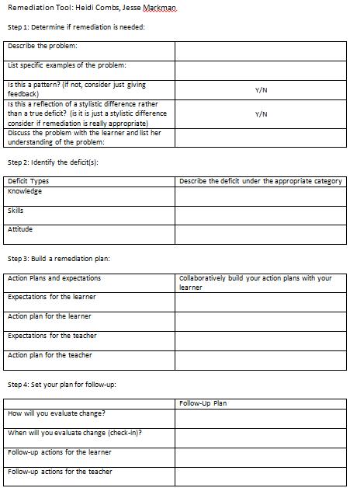

Slide 47
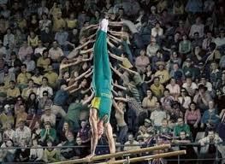
Your turn!

Slide 48
Small Group Case Practice
Break into pairs
Select a case that is vexing you or vexed you in the past.
Work through the case using the Remediation Tool
You may need to make an educated guess for some of the information if it is a situation that is evolving

Slide 49
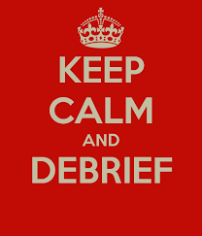
Post activity discussion
In historic cases had you followed the steps?
Any sticking points?
Any patterns?

Slide 50
Take home points
Remediation is most successful when developed in a structured way through a collaborative partnership
Being familiar with the key steps of teaching can help with identifying if there is a problem and what it might be
Don’t wait too long or the window of opportunity closes

