Slide 1
Writing Evaluative Comments for Any Student and Translating Them into Letters of Recommendation (aka “Leaving Lake Wobegon”)
Jeanne Cawse-Lucas, MD
September 13, 2019
Notes:
Mostly focused on LOR for residency application, but generalizable
LORs are used a lot in application process for med school and residency. In FM, over 80% of programs use LOR to decide whom to interview
Sounding Board: “Fantasy Land” NEJM 3/17/1983 “Tonight I traveled to a wondrous place, a fantasy land of sugar plums and fairy tales. Since some of you may never have the opportunity to visit this glorious place, let me tell you about it. It is a land where everyone “will make a fine physician,” where people have “excellent interpersonal skills” and “good rapport with their peers.” In this land, about a tenth of the inhabitants are “among the finest I have ever worked with,” a full quarter are “outstanding,” and almost all ar “in the upper quarter.” Everyone is “a pleasure to work with,” has “excellent initiative,” is “enthusiastic and conscientious,” and possesses and “above-average fund of knowledge.” A few people are quiet or shy or get off to a slow start, but they all “blossom during their clinical years,” and no one has “reservations” about anyone. No one is ever poor, fair, or average; they are all “very good” or “excellent.”

Slide 2
Learning Objectives
At the end of this activity, the participant will be able to:
Identify helpful and harmful characteristics in a evaluative documentation
Incorporate use of competency-based frameworks
Formulate elements of a concise, credible, contextual, concrete, and comparative LOR
Notes:
Jeanne

Slide 3
Disclosure
I am an academic advisor
My goal is to get students matched into residency
I am also a clerkship director.
I edit your written evaluation comments.
The better they are, the less work it is for me☺

Slide 4
Top 10 Factors Used in Residency Selection
USMLE Step 1
Specialty Specific Letter of Recommendation
Medical Student Performance Evaluation (MSPE/Dean’s Letter)
USMLE Step 2 CK
Grades in required clerkships
Personal Statement
Class ranking/quartile
Any failed attempt in USMLE
Grades in clerkship in desired specialty
Evidence of professionalism and ethics
2016NRMP Program Directors survey
Notes:
The two bolded are in the 80-90% range in terms of proportion of programs that use
Family Medicine
USMLE Step 1 Score (90%)
Perceived commitment to specialty (89%)
USMLE Step 2 CK score (89%)
Specialty specific Letter of Recommendation (88%)
Personal Statement (88%)
Internal Medicine
USMLE Step 1 Score (93%)
USMLE Step 2 CK score (91%)
MSPE (90%)
Any failed attempt in USMLE (81%)
Specialty specific Letter of Recommendation (80%)
OBGYN
Grades in required clerkships (92%)
USMLE Step 1 Score (91%)
Specialty Specific Letter of Recommendation (87%)
USMLE Step 2 CK Score (83%)
MSPE (81%)
Pediatrics
USMLE Step 1 score (94%)
USMLE Step 2 CK score (89%)
Grades in required clerkships (86%)
MSPE (84%)
Class ranking/quartile (83%)
Emergency Medicine
Specialty Specific Letter of Recommendation (97%)
USMLE Step 1 Score (96%)
USMLE Step 2 CK score (89%)
Grades in specialty related clerkship (81%)
MSPE (79%), Away rotation in your specialty at another institution (79%)

Slide 5
How are your evaluations used?
Formative comments = Required Feedback section.
Helpful for the student in their subsequent clerkships, names things to build on or deficits
If this is really fleshed out, you can use this as the basis of an LOR later
Summative comments become the Med Student Performance Evaluation (MSPE)

Slide 6
Basic Summative Comments Guidelines
Past tense
Complete sentences
Third person
Minimum of 3 sentences of substance
Maximum of 350 words
This is not a LOR – “I would be happy to write a LOR” goes in the formative section

Slide 7
Descriptors
Magnificent Superlative Extraordinarily strong Notable Wonderful Humble | Accomplished Well read Capable Friendly Well groomed About to blossom | Present English speaking Ambulatory Well perfused Charmingly fresh in outlook Eukaryotic
Schneiderman, H. Le Mot Juste. JAMA. 1988;259(1):87.
Notes:
Pam

Slide 8
Efficient.
A. Gets the work done quickly so he can see more patients
B. So anxious about interacting with patients that he escapes from the exam room as soon as he is able
C. Notes never longer than 20 words from start to finish
Notes:
Pam

Slide 9
Arrived early and stayed late
A. Wanted to make a great impression on his preceptors
B. Extremely interested in giving good patient care
C. Struggles with time management
Notes:
Pam

Slide 10
What do I do with THIS?! (or worse…)
Notes:
Jeanne
“Middle of the road” is not “BAD.”
Highlight the student’s strengths
Use writing your formative comments as an opportunity to draft a LOR. Then the student knows exactly what he’s getting
Waiving the right to see the letter does not mean that you can’t SHOW the student the letter

Slide 11
Competency Frameworks in LOR
Possible references
Clerkship grade anchors (not quite competencies, but someday may be)
FM ACGME Core Competencies
PA Core Competencies
AAMC’s Physician Competency Reference Set
Components
Patient Care
Medical Knowledge
Practice based learning
Interpersonal and Communication Skills
Professionalism
Systems based practice
Interprofessional Collaboration
Personal and Professional Development
Notes:
Amanda
FM ACGME and PA have the same core 6. the AAMC adds 2 more in italics

Slide 12
Use of competencies
Anchors or milestones along the developmental trajectory of competencies can be standardized across institutions
Would capitalize on frameworks of achievement most people are already familiar with.
Could potentially avoid some bias through the use of standardized, competency based language
Could be used to develop intern learning and improvement plans once matched
Notes:
Amanda

Slide 13
FM Grade Anchors
https://depts.washington.edu/fammed/wp-content/uploads/2015/03/FMC-Grade-Anchors-.pdf

Slide 14
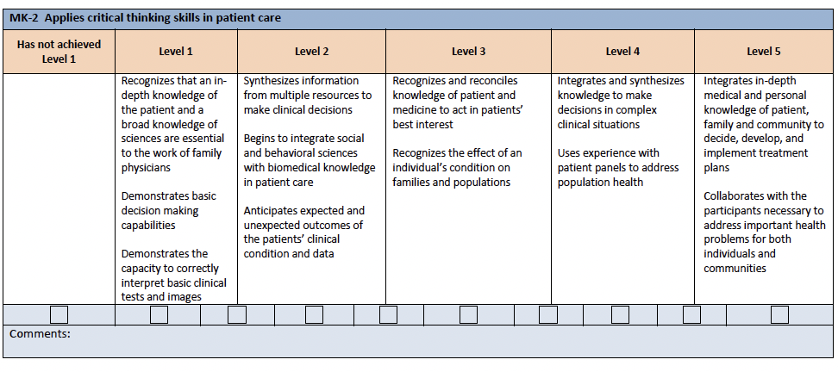
Family Medicine ACGME Competencies
https://www.acgme.org/Portals/0/PDFs/Milestones/FamilyMedicineMilestones.pdf?ver=2017-01-20-103353-463
Notes:
Amanda

Slide 15
Well read.
He researched about clinical questions and included information from appropriate sources in his assessments and plans.

Slide 16
Unconscious Bias
A bias we are unaware of and that happens outside of our control
Science faculty’s subtle gender biases favor male students
Moss-Racusin et al, PNAS, Oct 2012
Exploring the color of glass: Letters of recommendation for female and male medical faculty
Trix and Penska Discourse and Society, 2003
Notes:
Measurable: Implicit Association tests (IAT tests) at implicit.harvard.edu
Book : Blind Spot: Hidden Biases of Good People by Mazarin + Greenwald
Excellent book on topic by leaders
Moss-Racusin: 127 science professors (Biology, Chemistry, Physics) evaluated resumes
Undergraduate student applying for a lab management position
Identical resumes(male or female), randomized
Female students viewed as less competent and less hirable than identical male students
Offered lower salary and less career mentorship
Faculty gender did not affect results
Bias was modest but real
But they liked the female applicant more
Trix and Penska:
300 LOR from one medical school, Compared letters by gender
Letters for women: Shorter, Lack of one of the 3 basic features, More likely to portray as teachers and students vs. Men as researchers and professionals, More doubt raisers
While not the best student I have had
She has a somewhat challenging personality
While his publications are not numerous as you know
He appears to be a highly motivated colleague
It appears that her health and personal life are stable

Slide 17
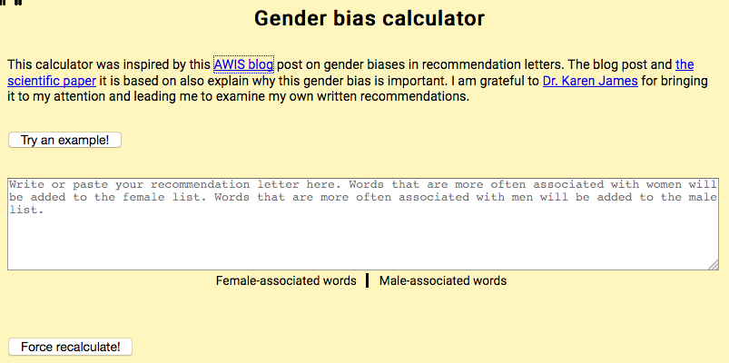
Unconscious Bias
http://www.tomforth.co.uk/genderbias/
https://www.linkedin.com/pulse/5-tips-writing-great-letters-reference-avoiding-bias-sharonne-hayes

Slide 18
Letters of Recommendation
Notes:
Transition to Pam

Slide 19
Background
83% of programs used LOR to help select which applicants to interview and 67% to make ranking decisions
EM and Otolaryngology found that narrative letters of recommendation were not reliable - letters are positively biased and inter-rater reliability is poor
Content and rated quality of letters are influenced by gender, both that of the writer and of the student
Cognitive knowledge, clinical judgment, work habits, and motivation are frequently left out
Notes:
cognitive knowledge, clinical judgment, work habits, and motivation, were frequently left out of NLORs,⁴ along with other contextualizing information, such as depth of understanding about the applicant, numeric comparison of applicants to their classmates, and summary statements Is there such a thing as traditional? This sounds like there is a standard somewhere. I would leave this work out.
Info about our work group: Re-examine current LOR for FM residency
How can we write better narrative LOR?
Is there any utility to a standardized letter of recommendation?

Slide 20
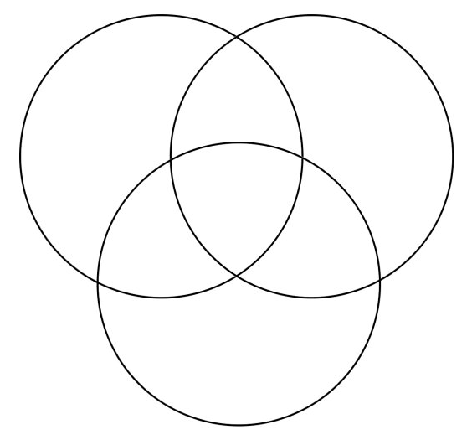
Writer
Advocate
Informant
Reader
Interpreter
Judge
YOUR
LETTER
Student
Optimist
Marketer
YOU
Notes:
Use of LOR (medical school, residency, fellowships)
What part do you have in reading/writing/using LOR in application processes?
What are some issues you’ve experienced?
Who has a LOR that they are worried about?

Slide 21
What’s Missing?
Notes:
Jeanne

Slide 22
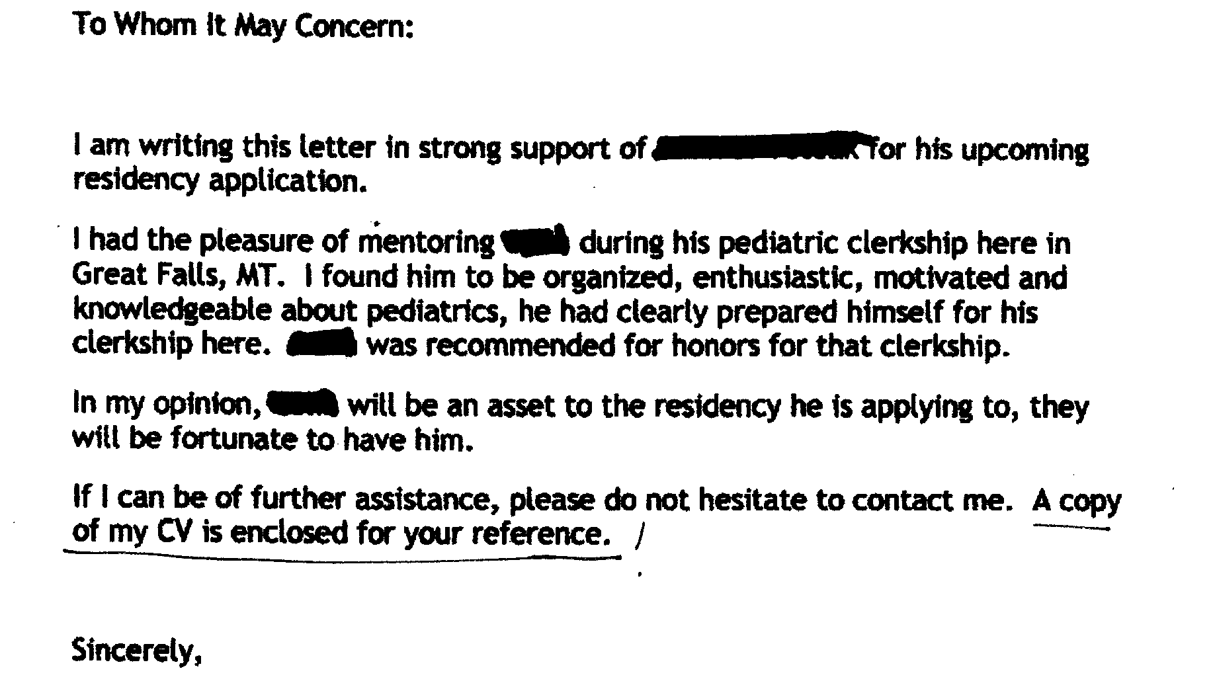
What’s missing?
Be specific about which specialty!
Always include the ERAS ID
State that the applicant has waived the right to see the letter
Give examples!
DO introduce yourself (at the beginning) and your teaching role. DO NOT include your own CV.
Notes:
Jeanne

Slide 23
Do you want to hire this guy?
Was he smart?
Did he make
good clinical
decisions?
So…. What are his strengths?
professorawesome@uw.edu
Notes:
Jeanne
Avoid damning with faint praise. Commenting on communication and work ethic without talking about clinical skills looks bad.

Slide 24
I can’t possibly write a good letter for this student!!! What do I do?
If you actually have not worked a lot with a student:
"I don't have enough data.”
“You worked a lot more with X, consider asking that person.”
If you have given lots of feedback and it's at the end of the block:
“We talked about a lot of things that you can do to improve. I would like to review your future clerkship evaluations later this year to demonstrate improvement and receptiveness to feedback.”
Have the student return for 1-2 days later in the year to show improvement.
Notes:
Jeanne

Slide 25
I can’t possibly write a good letter for this student!!! What do I do?
Our students need letters of recommendation …
and you may be their best option.
Honesty is the best policy.
Let them know that this will be an honest letter but you will highlight strengths.
Special Circumstances:
How does the applicant want to address the issue?
Use it as an opportunity to highlight the strengths of the applicant
Notes:
Jeanne

Slide 26
Your evaluation comments can inform your LOR
What are their strengths?
What wasn’t so great but they were making progress and had a good attitude? Use the competencies to make it sound great☺

Slide 27
Best Practices: The “5 C’s”
Concise
Credible
Contextual
Concrete
Comparative
Created by Ken Steinberg, MD and Chris Knight, MD
Notes:
Jeanne
Commitment and relationship with applicant
Specificity of focus
Evaluation of traits and accomplishments

Slide 28
Best Practices
Introduction
Who are you?
Teaching role?
How well do you know the student?
Don’t forget the ERAS ID and that the student has waived the right to see the letter

Slide 29
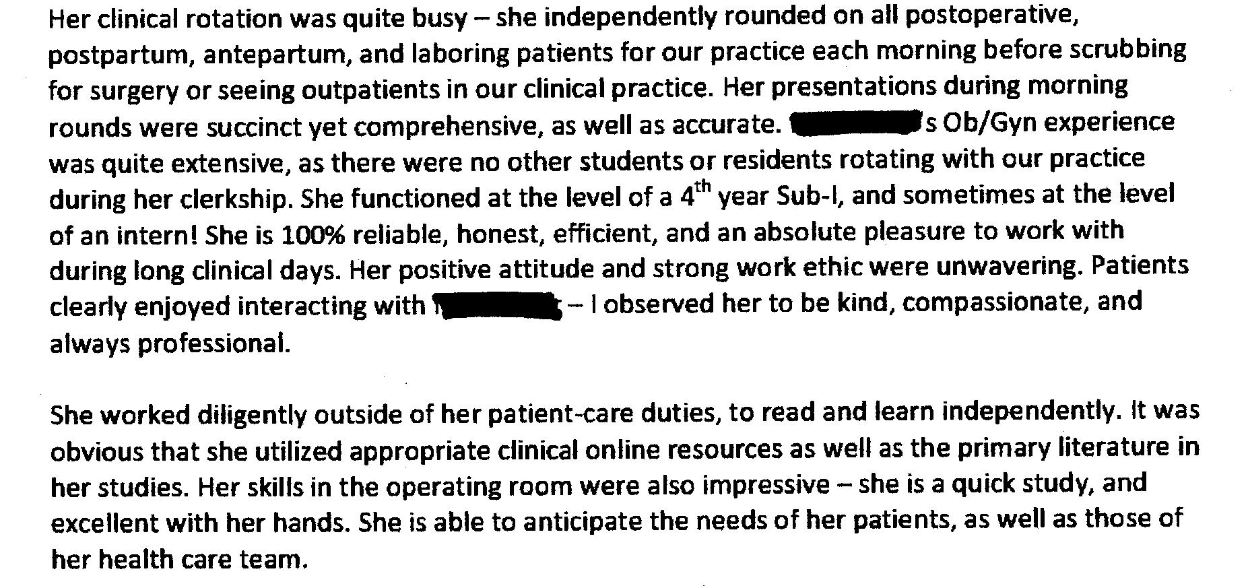
Body
Describe the student’s strength that you OBSERVED
Be as generous and specific as possible
Describe anything else that makes the students unique

Slide 30
Summary
Recap the student’s strengths and what sets them apart
Do you want the student in your residency/specialty? Say so!
Comparative statements are often valued by residencies

Slide 31
NEVER FORGET THESE THINGS
Write the letter on letterhead
Make sure to sign it
Put the student's ERAS ID number on it at least once
“I am pleased to recommend Bob Smith (ERAS ######) for a position in your residency program”
State that the student has waived the right to see the letter
Don’t call the student “Dr.” unless she has earned a doctorate. Use student doctor, Mr./Ms., or first name.

Slide 32
Acknowledgements
Thanks to Drs. Tomoko Sairenji, Amanda Kost, and Pam Pentin for their contributions to this presentation

