Slide 1
The Pediatric Clerkship
You’ve Got the WRITE Stuff
Bekah Burns, MD

Slide 2
Learning Objectives
Describe how the Pediatrics grade is calculated
Identify how comments are used to provide feedback and develop the MSPE text
List some tips for completing various sections of the form

Slide 3
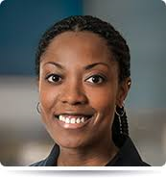
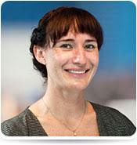
The Making of a Grade
WRITE “numerical grade”
Inpt “numerical grade”
Fail, Pass, High Pass, Honors

Slide 4
The Grading Rubric

Slide 5
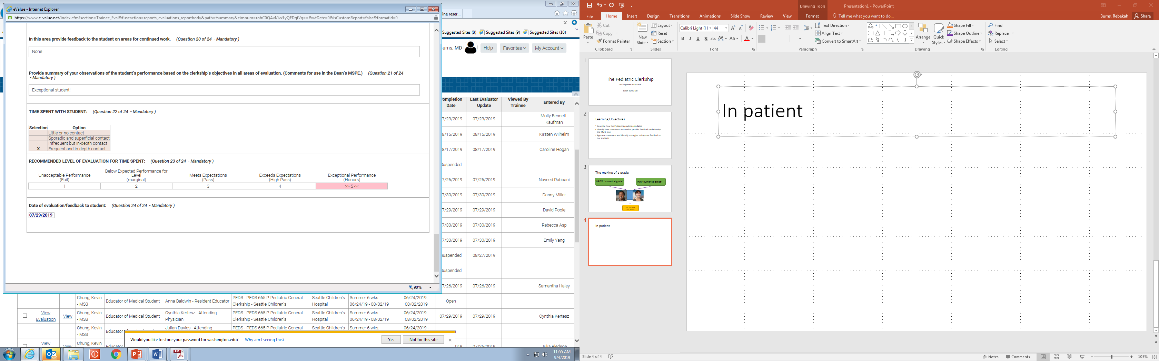
Inpatient
Notes:
3-17 numbers
Only infrequent or frequent count

Slide 6
Non-WRITE Example
Notes:
Honors

Slide 7
WRITE Numerical Grade

Slide 8
WRITE Example
Notes:
High Pass

Slide 9
Meanwhile……
XX has consistently performed above average in medical knowledge, data gathering and synthesizing. He is dedicated and has an outstanding work ethic. He is consistently reliable, compassionate, and has shown excellent growth throughout his TRUST clerkship. He is a pleasure to teach and a great team member. Numerical grade- 4.48.

Slide 10
And now……
Notes:
Honors

Slide 11
Evaluation Categories
Knowledge of subject
Data-gathering skills
Clinical reporting skills
Procedural skills
Integration skills
Management skills
Patient-centered care skills
Communication
Relationships with patients
Professional relationships
Educational attitudes
Dependability and responsibility
Notes:
1=unacceptable
2=below expectations
3= meets expectations
4= exceeds expectations
5=exceptional

Slide 12
Tips
The final grade is NOT calculated directly from the evaluation categories.
Always include “The numerical clinical performance grade is [INSERT calculated number-(0-5.0)]” in the MSPE.

Slide 13
Comments- The Good, the Bad, and the Ugly

Slide 14
Areas of Interest
Knowledge
History/PE (data gathering)
Presentations/data reporting (organizing data)
Clinical reasoning (interpreting data)
DDx and assessment and plan
Rapport
Teamwork/professionalism
Educational attitudes

Slide 15
Areas of Strength
Acquires exceptional histories, synthesizes data very quickly, and interprets that data into correct diagnosis.
Very knowledgeable about treatment plants for general pediatrics.
Excellent communication with patients and families; Naturally builds rapport quickly.
Is a calming presence to both patients and the team.
Fund of knowledge above average.
Takes initiative with patient care and follows through.

Slide 16
Areas of Strength
Brilliant engaged student
Patient interaction was wonderful
Excellent knowledge base
Has an excellent knowledge base.
Eager to learn and did an excellent job listening and aligning with parents goals of care.
His ability to respond to feedback greater than any medical student the preceptor has ever worked with. He took every suggestion, and incorporated it into his future presentations.
He is very thorough and good at communicating with families.
He did very well at doing a physical exam while making sure the child felt comfortable.

Slide 17
Tips
Refer back to areas of interest
Provide at least 2
If possible comment how their performance compares to other students at the same level of training
Be specific

Slide 18
Areas for Growth
Expand plans to include discharge needs and discharge education for families.
Continue to work to be sure that you are communicating plans and changes in patient status to nursing and other support staff to ensure good team communication.
Continue to keep an open mind for "can't miss" diagnoses even with the most common of chief complaints.

Slide 19
Areas for Growth
No specific concerns

Slide 20
Areas for future work/growth:
Continue to work on concise oral case presentations as tend to ramble at times.
Also need to continue to work on development of differential diagnosis and plan even if wrong and move out of reporter mode to more interpreter role.
Continue to work on engaging families and finding commonality to be able to reach patients at their level.
Continue to work on oral case presentations, particularly in duration and summation of pertinent information.
Continue to work on development of broad differential diagnosis and plan even if wrong; Move out of reporter mode to more interpreter role.
Continue to work on engaging families and finding commonality to be able to reach patients at their level.
Begin to anticipate clinical changes and start to plan for possible worsening.

Slide 21
Tips
Be specific and offer a suggestion
Provide at least 2
Everyone has something they can work on
Avoid the generic “read more”

Slide 22
MSPE

Slide 23
Content
200-300 words
Blended from inpatient and outpatient
Summarizes student and reports grade and test score

Slide 24
Areas of Interest
Knowledge
History/PE (data gathering)
Presentations/data reporting (organizing data)
Clinical reasoning (interpreting data)
DDx and assessment and plan
Rapport
Teamwork/professionalism
Educational attitudes

Slide 25
Shining Example
X is the brightest, most organized, most empathetic and kindest student doctor I have the pleasure to teach. He came to the rotation well read and prepared and while here continued to expand his knowledge base. During the rotation he researched assigned and unassigned topics and presented concise summaries to his preceptor. His case presentations were thorough, well organized and logical. His written notes were concise, well thought out with excellent differential diagnoses and easy to follow. He demonstrated a thorough understanding, beyond basic Pediatric principles of medicine, and was able to apply that knowledge to his patients. He was not satisfied with superficial answers, but dug deeper. His presentations informed the diagnostic decisions. His physical examination skills were smooth, thorough and complete. He was professional, compassionate, caring, and respectful in his interactions with patients and their parents. He had good rapport with the families, he was knowledgeable about the information in his patients' charts, their history, and always worked to develop a diagnosis and plan. X was dedicated to his responsibilities and was always on time and prepared. He was a pleasure to work with and was well received by clinic staff. He is above and beyond where we expect him to be at this time in his training. The numerical clinical performance grade is 4.75.

Slide 26
When there are fewer positives to say…..
Throughout his WRITE he improved his notes and presentations. Improved his ability to relate and interact with families and seemed much more at ease with explain exam and assessment and plan. One preceptor wrote “XXX is a pleasure to have as a learner. He easily integrates into most pediatric visits and shows interest in learning."

Slide 27
Tips
Provide at least 100 words
Tell the story of a specific cases or patient interactions that were memorable and why
Comment on areas that student is above average compared to peers
Comment on trajectory when improvements were primary focus
Highlight where student really shined

Slide 28
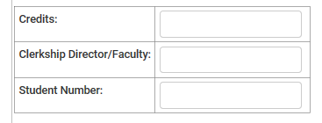
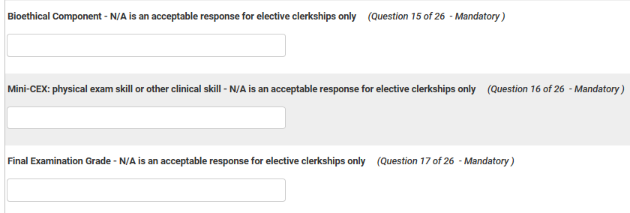
What about those other boxes?

Slide 29
And the answer is……
Credits
Student number
Bioethical Component
Final Examination Grade
Mini-CEX
Unknown
NA
Completed

Slide 30
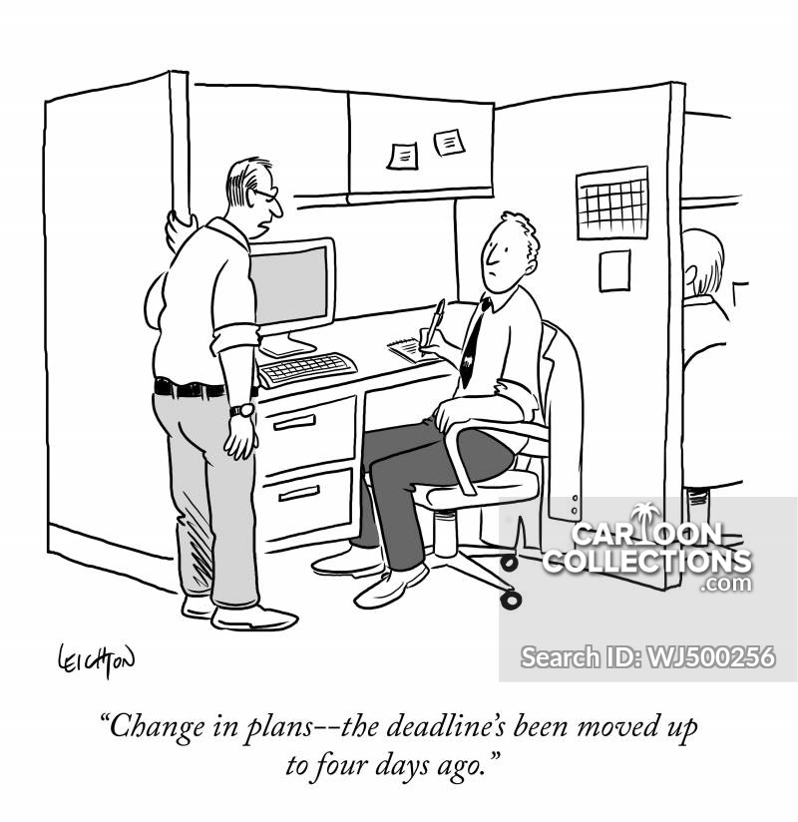
Deadlines
Notes:
1-2 weeks after student finishes. 4 weeks is when we have to turn them in.

Slide 31
Questions?

