Slide 1
Teaching in a Busy Clinical Practice
Serena Brewer, DO
Jeanne Cawse-Lucas, MD
September 13, 2018
Notes:
Co-director FM Clerkship
Director PCP
This talk is based on feedback from clerkship and PCP students, as well as best practices developed by PCP faculty as well as clerkship faculty

Slide 2
Learning Objectives
Utilize a tool for setting goals and expectations: GLEAM
Describe best practices for the pre-clinic huddle for clinical student teaching
Describe strategies for student scheduling
Demonstrate at least one method of in-the-moment feedback Ask-Tell-Ask or 1-Minute Preceptor
Notes:
What are your Goals and expectations for this mentorship? What are your goals and expectations for your career? What do you feel are your content deficiencies and skill challenges?
How do you Learn most effectively? What has helped you succeed? What did you find challenging? How do you like to receive feedback? What is your learning style? How do you best assimilate material and experience?
What previous patient Experiences have been meaningful to you? What worked for you and helped you learn? What seemed to derail you? Have there been other mentors who seemed to be particularly helpful?
What Activities are you involved in outside of medicine? Consider exploring the student’s support system. What other roles/responsibilities do you have in your family and community?
What More do I need to know about you to make this an optimal mentorship experience for you? What have I forgotten to ask you? Do you have any questions for me?

Slide 3
Day 1 Clinic Orientation
Population
Preceptors
Contacts
IT
Hydrate
Caffeinate
Micturate
Notes:
You, clinic manager, whom to call if the student can’t make it, etc.
Remember that this is ALL NEW to the student. Don’t assume that they know anything.
Invite participants to share their experiences as we go through

Slide 4
“I'd like [my faculty] to … sit down with me and go over goals and expectations.”

Slide 5
GLEAM
Goals
Learning style
Experiences
Activities
More
Notes:
Jeanne
The GLEAM is a tool that is particularly useful when you will be with a student for more than 1 session
You can also use a couple of pieces of this for your preclinic huddle (Goals, Experiences in particular)
What are your Goals and expectations for this mentorship? What are your goals and expectations for your career? What do you feel are your content deficiencies and skill challenges?
How do you Learn most effectively? What has helped you succeed? What did you find challenging? How do you like to receive feedback? What is your learning style? How do you best assimilate material and experience?
What previous patient Experiences have been meaningful to you? What worked for you and helped you learn? What seemed to derail you? Have there been other mentors who seemed to be particularly helpful?
What Activities are you involved in outside of medicine? Consider exploring the student’s support system. What other roles/responsibilities do you have in your family and community?
What More do I need to know about you to make this an optimal mentorship experience for you? What have I forgotten to ask you? Do you have any questions for me?

Slide 6
Pre-Clinic Huddle
What is the student working on?
Are there any particular expectations (from student or faculty) for that day?
Which patients* may help meet those goals?
*Primary Care Practicum students should interview 1-2 patients per half day;
clerkship expectation is 3-4 per half day
Notes:
Serena
If heavy residency audience, this could also be useful to talk about which pts to see, pregame if residents have any questions about patients
Finding out what the student is working on makes it easier to provide feedback at the end, too.
How might the day go? Will they shadow you some? Make first contact always? Do you want to present in the room or outside of the room?
This is also a moment in which you can spend a minute teaching about good questions to ask for a particular concern, like red flags for low back pain or indications for antibiotics for respiratory infection

Slide 7
Active Shadowing
When interviewing, ask the student if s/he has any additional questions for the patient
Include the student in the physical exam. Point out abnormal findings!
Talk through your clinical reasoning. (Patients like this, too!)
Ask your colleagues to keep an eye out for good cases and come grab the student
Notes:
Jeanne

Slide 8
“I would like [my faculty] to teach me and test me. Give me a small doable specific task and then evaluate me on the spot.”

Slide 9
“Let’s go in together. You take the history and I’ll be your scribe.”
“I want you to take 10 minutes to interview the patient. I’ll knock on the door and you present what you’ve found.”
“I don’t know what the best next step is. Can you look it up and we can talk after I see the next patient by myself?”
Notes:
Jeanne

Slide 10
Other Ways to Schedule Students
Create a parallel schedule for your student. Visit template is 1 hour, slightly staggered from yours
(make sure to decrease your own schedule a little bit since you have to see and examine every patient!)
Block a catch-up slot in the middle of a half-day session
Wave scheduling: double book at the top of the hour and see 2-3 patients while your student sees one
Notes:
Serena
Have participants offer any additions

Slide 11
Two Students at Once?!
Students of different levels or disciplines teach each other
Stagger the students’ patients
Have students observe each other
Notes:
Serena

Slide 12
Opportunities for Student Continuity
Assign students to an OB patient and help the student follow that patient through delivery
Schedule follow up visits for days that students will be with you
If students sees a patient in hospital, have the student see them for hospital follow up as well
Give the students an opportunity to follow patients to specialists, imaging, and therapies
Notes:
Have people offer their suggestions serena

Slide 13
Best Practices for the Patient Centered Observation Form
Focus on a couple of sections of the form and observe and give feedback on those only
Consider the encounter to have 3 parts: rapport and agenda setting, history and physical, and decision making and closure. Please observe each part at least once
The ABFM is piloting education-oriented Part IV modules and the FM clerkship team is developing a module on the PCOF

Slide 14
CMS Documentation Update
CMS continues to pay only for those services provided by the Teaching Physician, but after verifying the history of present illness and re-performing the exam and medical decision making, the teaching physician may now verify and attest to the medical student’s documentation without having to re-document the findings.
Notes:
jeanne

Slide 15
Choose the method that works best for you!

Slide 16
Ask-Tell-Ask
Ask the trainee to assess his/her own performance
What went well? What areas need improvement?
Tell
Share your impression of positive behaviors and areas of concern
Provide suggestions for problem solving
Ask
Ask what areas could be improved
Allow the trainee to develop a specific plan for improvement
Add
Add any other things you think could be improved
Summarize the positives and areas for future growth

Slide 17
Ask-Tell-Ask
https://www.youtube.com/watch?v=SYXgMobMU8U
(or google “Ask-Tell-Ask Columbia”
and click the youtube link)

Slide 18
Why OMP?
Condensed way to streamline assessments, instructions, and feedback
Saves time when a full case presentation is not necessary
Using OMP improves the quality of feedback in ambulatory settings
Salerno et al. Faculty Development Seminars Based on the One-Minute Preceptor Improve Feedback in the Ambulatory Setting. JGIM. 17 (10) :779-787. 2002.
Aagaard, et al. Effectiveness of ghe One-Minute Preceotor Model for Diagnosing the Patient and the Learner: Proof of Concept. Academic Medicine. 79 (1): 42-49. 2004.
Notes:
Serena to introduce

Slide 19
What is the One Minute Preceptor (OMP)?
Get a commitment
Probe for supporting evidence
Teach general rules
Reinforce what is right
Correct mistakes
Neher, et al. A Five-Step "Microskills" Model of Clinical Teaching. Journal of the American Board of Family Medicine. 5:419-424, 1992.

Slide 20
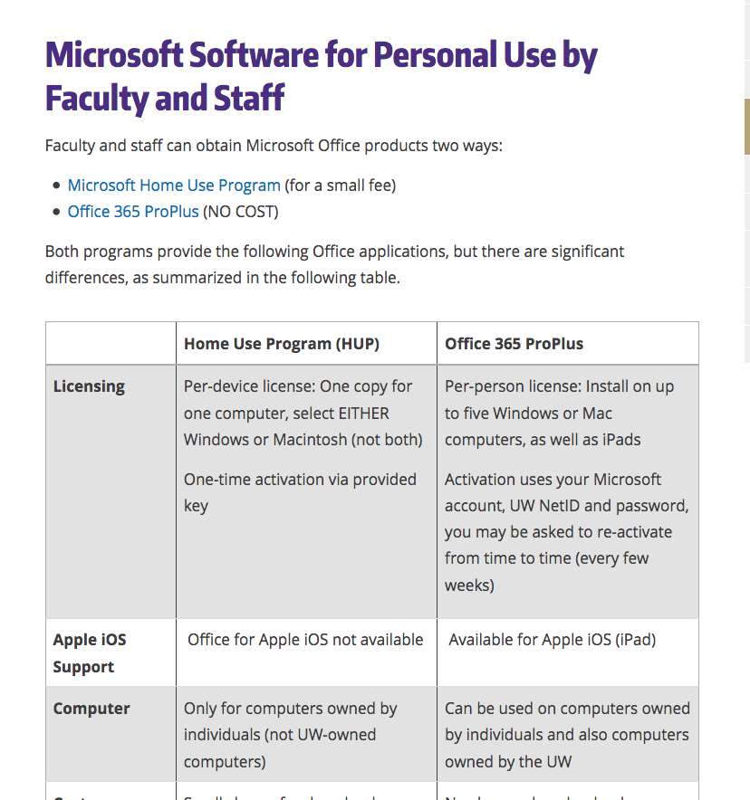
https://itconnect.uw.edu/

Slide 21
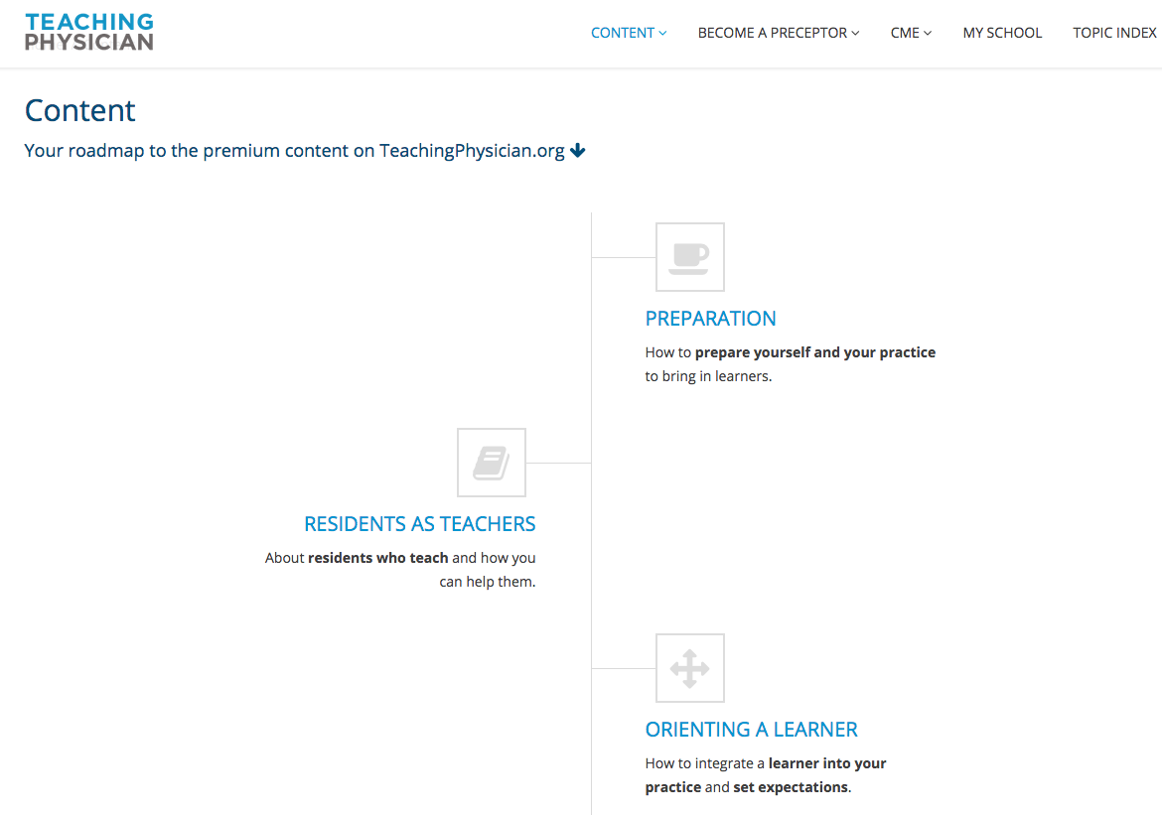
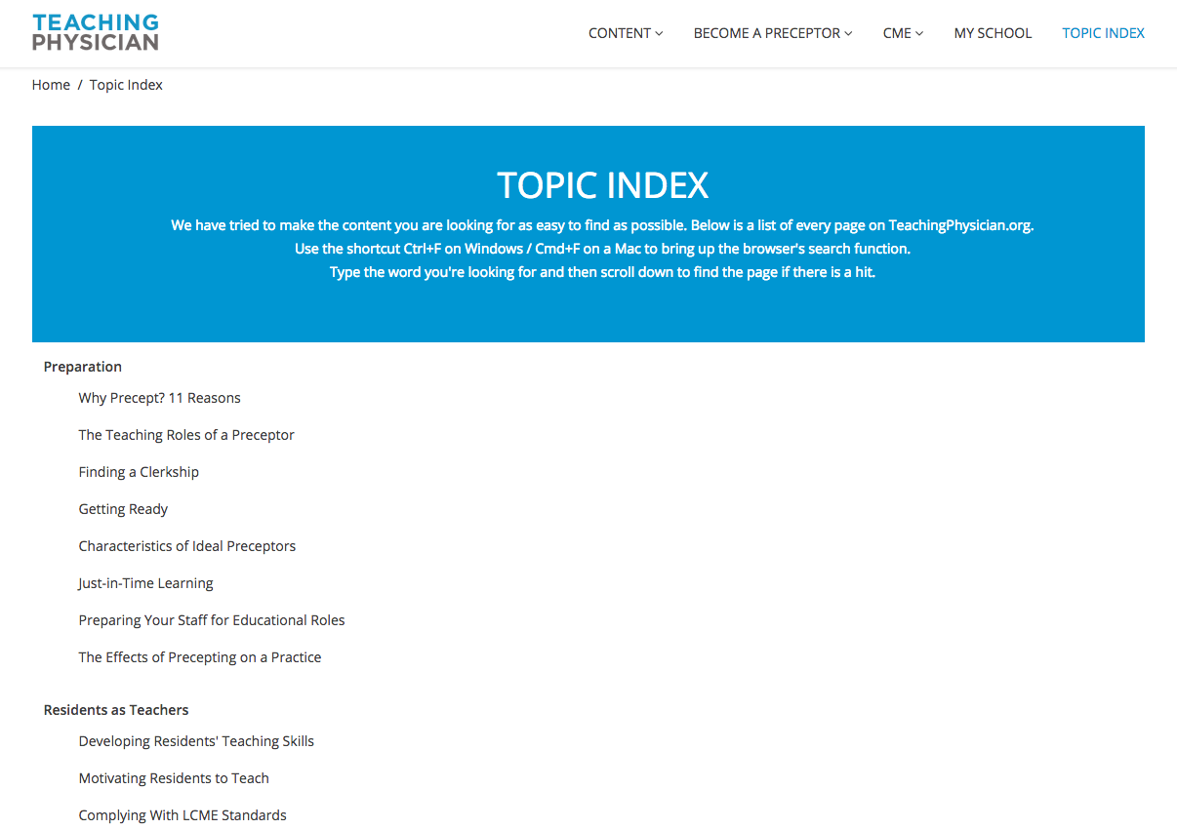
Teaching Physician
www.teachingphysician.org
username: uwfamedmse
password: uwfamedpassword
Notes:
https://www.teachingphysician.org/content/teaching-strategies/tipps-teaching-in-the-presence-of-patients

Slide 22
www.hsl.uw.edu

Slide 23
https://hsl.uw.edu/toolkits/care-provider/

Slide 24
Clinical Faculty Appointments
http://depts.washington.edu/fammed/administration/clinical-faculty-appointments
This will give you a UW Net ID

Slide 25
Contact
Jeanne Cawse-Lucas
cawse@uw.edu
Serena Brewer
sbrewer@swmtchc.org

