Slide 1
TRUST &
Ecology of Health and Medicine (EHM)
Notes:
Group Introduction (names & role)

Slide 2
Disclosure
There is no actual or potential conflict of interest in relation to this presentation.
Notes:
(Danielle)

Slide 3
Goals for the Session
Summarize Ecology of Health & Medicine (EHM) goals/objectives
Explain the collaboration between EHM Course leads and TRUST team to meet EHM & TRUST objectives
Provide examples on how EHM content has been modified to meet TRUST objectives
Engage and obtain input from session attendees to discuss next steps and how we move forward as team
Notes:
(Kim)

Slide 4
History of EHM Course
Themes have been a curricular gap
Students desire more robust theme material
EHM will occur across all four years of curriculum (7 weeks total)
Allows for integration, development of skills and depth of content
Occupies time blocks formally known as “intersession weeks”
All students must complete course requirements
Notes:
(Danielle)
Course content is dispersed throughout the four years of medical school, one week at a time throughout Foundations, Patience Care phase, and Explore & Focus phase.
Intersession was a time students would take a break or register non-clinical selectives. For TRUST students would use this time to go out their TRUST site.
WWAMI-wide student interaction is lacking

Slide 5
Integrated EHM Course Themes
Diversity
Ethics
Global, Population & Public Health
Health Equity
Healthcare systems
Interprofessional Education (IPE)/Communication
Lifelong learning
Professionalism
Social Determinants of Health
Systems Improvement
Notes:
(Danielle) The EHM course integrates 10 themes throughout the four year curriculum. These themes are listed.

Slide 6
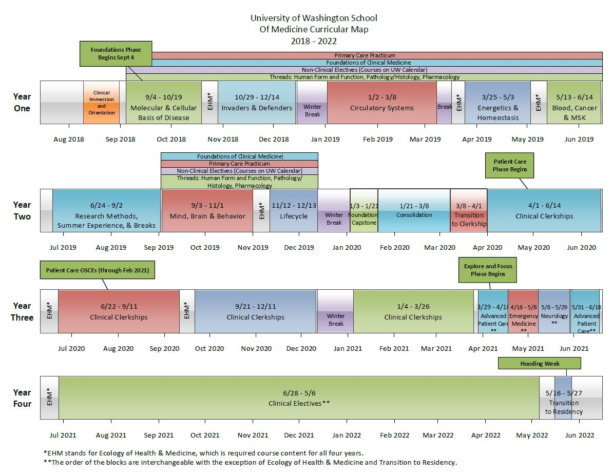
Notes:
(Danielle)
With this curriculum schedule schematic, we would like to highlight how the EHM course fits into the overall UWSOM curriculum.
Emphasis this is visual applies for the E-18
Subject to change and communication about changes will be shared by TRUST team

Slide 7
TRUST, EHM, and Curriculum
Collaboration with EHM Team and Curriculum Committee to:
Ensure TRUST and EHM course goals are met
Confirm weekly session objectives are met via modified curricula for TRUST scholars
Allow TRUST scholars to complete EHM content through experiential or student-led assignments in the clinic and/or community at their TRUST site
Notes:
(Brenda) Despite EHM being a new course, the TRUST team meets with the EHM course leads and team every month to ensure the course goals are met through TRUST’s experiential assignments while at their site.

Slide 8
EHM WEEK 2
Session Objectives: Social Determinants of Health in US Populations
Describe the US epidemiological profile.
Identify and describe social determinants and how they operate at different levels of social organization (e.g., community, society).
Define and explain the difference between disparities, inequalities, and inequities.
Utilize a “causes of cause” approach to identify how structural changes might minimize health inequities.
Notes:
(Brenda) One example of how the TRUST team has worked with the EHM course leads to modify an EHM session was during week 2 of EHM. The TRUST students were at their respective sites and for the SDoH in US Populations sessions TRUST students had a slightly different experience in meeting this sessions goals.

Slide 9
TRUST-EHM Curricula Modified
Foundation Campus: Small Groups
TRUST Scholar: Interview Patient
Pre-work
Reading
Video
Large Group Session
Review Social Determinants of Health PPT
Discussion on “fundamental causes” of diseases
Small Group Session
Review cases
Assessment
Pre-work
Reading
Video
Social Determinants of Health Voiceover PPT
Preceptor/Student Involvement
Set up patient interview prior to EHM Week
Session
Interview patient with provided questions
Debrief interview with preceptor (optional)
Assessment
Notes:
(Danielle)
Start session (both groups)
**Pause for questions once discussing this slide***
Health Equity Quiz
Small group session –
Two cases to answer the following:
What are the social determinants at play in each case?
How can a causes of causes approach help to identify the fundamental causes of each case?
What components of the social ecological model can be applied to each case? (Students can use worksheet for this)
What structural changes might help improve health and at what tiers of the social ecological model?
Assessment – Social Determinants of Equity
Read an article that address the health impact of a social determinant of equity. After reading, propose an intervention to address this issue in healthcare.

Slide 10
Group Activity
Help us develop a TRUST EHM week-4 session
Week 4 Session – Ethics: Complexity of Decisional Capacity
In small groups review the following materials:
Session objectives
Summary points of the readings
Cases that will be used by non-TRUST students
NOTE: EHM Week 4 dates are Monday, November 5th – Thursday, November 8th
Notes:
(Kim & Toby)
To include:
Instructions for group activity
All students need to meet objectives, pre-work, assessments
We have flexibility of how they carry out the assignment
How would you modify this curricula for this particular session, be mindful of the session time (e.g. this is a 90 min session and how will this session be the same for TRUST)
- Facilitators guide for the 2 sessions (ASK JAIME) otherwise use session objectives only

Slide 11
Group Activity Continued…
In small groups brainstorm an activity idea to translate this EHM session for TRUST students.
Session guidelines:
Activity should take about one hour to complete
Activity should align with the session objectives
Activity could take place in the clinic, community or an interactive video conference call via Zoom with UW faculty and other TRUST Students.
Notes:
(Kim & Toby)

Slide 12
Summary
EHM has been integrated into seven week-long sessions across all three stages of the curriculum
This new course continues to evolve
TRUST sites and preceptors are key stakeholders for EHM-TRUST
Notes:
(Kim & Toby)
EHM is here to stay
Course is evolving, we are collaborating to ensure TRUST goals are being met
This work new course and modified curricula could not happen without the support TRUST preceptors. We look forward to your continuous support as it relates to required EHM curricula
Students feedback are enjoying this content

Slide 13
QUESTIONS Thank you for your continued support!
Further Questions – Contact:
Brenda Martinez: bnmb107@uw.edu
Notes:
Brenda

