Slide 1
Electronic Resources for Clinical Faculty

Slide 2
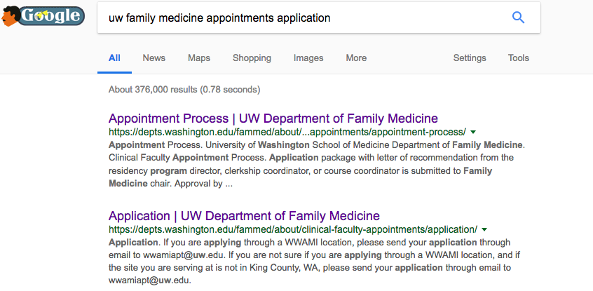
Clinical Faculty Appointments
https://depts.washington.edu/fammed/about/clinical-faculty-appointments/application/
(or google “UW Family Medicine appointments application”)

Slide 3
https://itconnect.uw.edu/

Slide 4
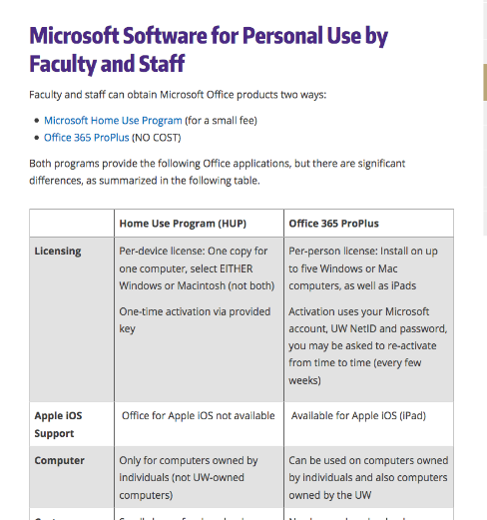
https://itconnect.uw.edu/

Slide 5
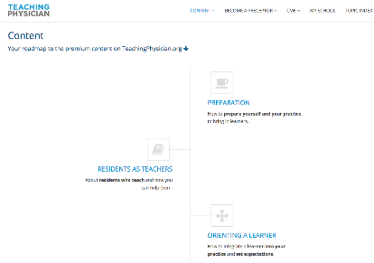
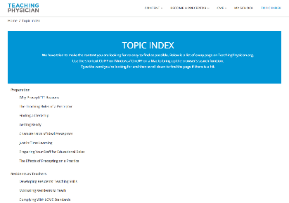
Teaching Physician
www.teachingphysician.org
username: uwfamedmse
password: uwfamedpassword
Notes:
https://www.teachingphysician.org/content/teaching-strategies/tipps-teaching-in-the-presence-of-patients

Slide 6
www.hsl.uw.edu

Slide 7
https://hsl.uw.edu/toolkits/care-provider/

Slide 8
Useful, Unlocked Links (can use without clinical faculty appointment)
Scroll down for chronic pain resources, CDC traveler resources
Notes:
CDC Traveler’s Health
CDC Immunization Schedules
Antibiograms
Familydoc.org patient information
Ethnomed (browse by topic or culture)
Chronic pain resources (all in one place)
Anticoagulation services
Scroll down for chronic pain resources, CDC travelers health

Slide 9
Other Useful tools
Up to Date, DynaMed, Access Medicine, Clinical Key
VisualDx
Micromedex
Natural Medicines
Procedures Consult

Slide 10
Review a topic
20 yo F with malar rash and arthralgias. Your practice is mostly geriatric and you suspect SLE and would like to review the topic:
UpToDate (author’s opinion, many references)
DynaMed (in good summary format)
Access Medicine (books, images)
Clinical Key (First consult gives summary)
All have high quality information that is regularly updated

Slide 11
Keeping current
You have a 65 year old man with atrial fibrillation with difficulty with warfarin management. You haven’t used dabigatran before and need to decide if this is a good choice for him.
Anticoagulation Services
MicroMedex
Cochrane Review
UpToDate

Slide 12
Anticoagulation Services

Slide 13
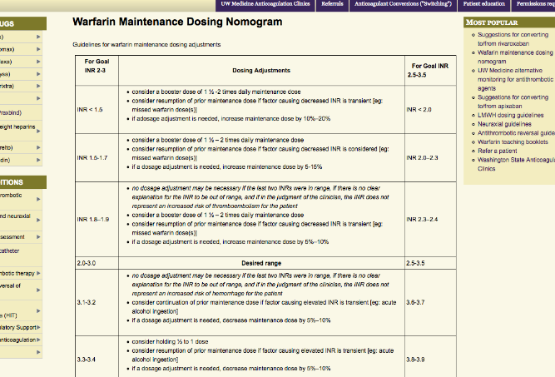
Warfarin Dosing Nomogram

Slide 14
Clinical decision making
50 yo F with: DM, SOB, fever. +smoker.
T=102.5, RR 26, BP 130/85, HR 105, mental status wnl
L sided crackles, CXR: L consolidation
PaO2=58 (~90% SaO2), glu=300, WBC=16K
QUESTION: Admit or not?

Slide 15
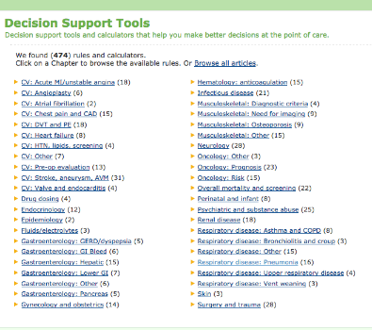
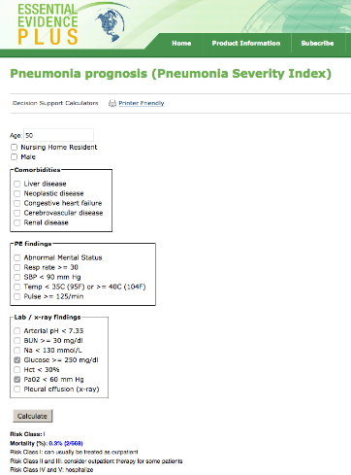
Essential evidence plus Decision Support Tools: Pneumonia Severity Index

Slide 16
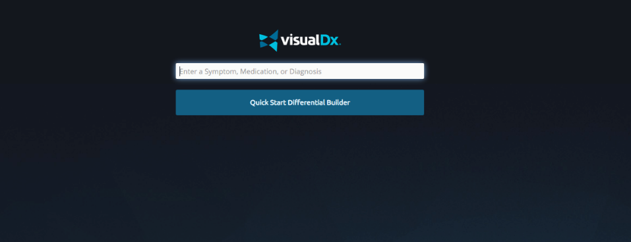
VISUAL DX
11 month old girl with fever, runny nose, cough, appears mildly ill, has facial, truncal rash that appeared this morning a few days after onset of symptoms
Get photos, information about disease including differential, treatment
Build a differential based on rash characteristics
Notes:
Put in disease name and get photos, information about disease including differential, treatment

Slide 17
Skin lesion diagnosis

Slide 18
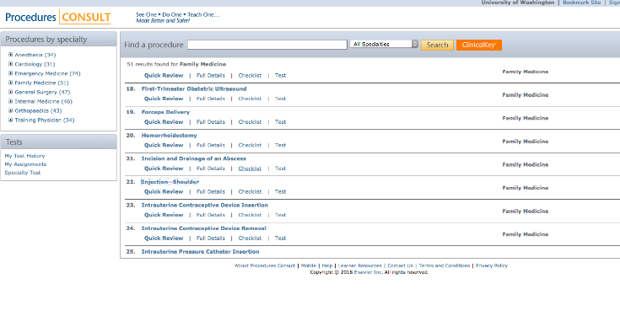
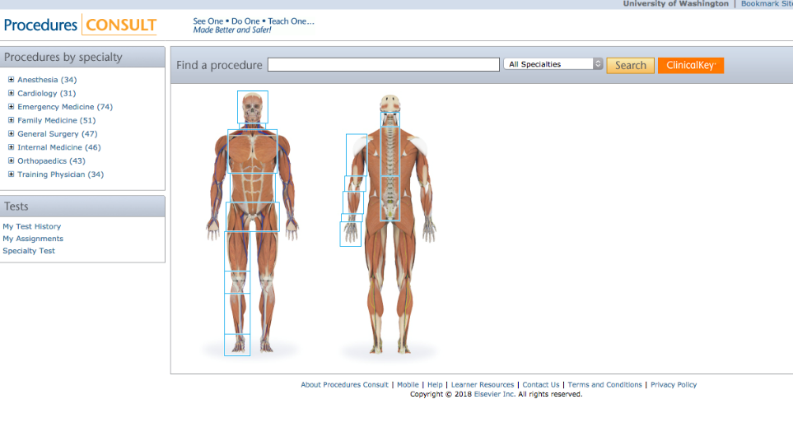
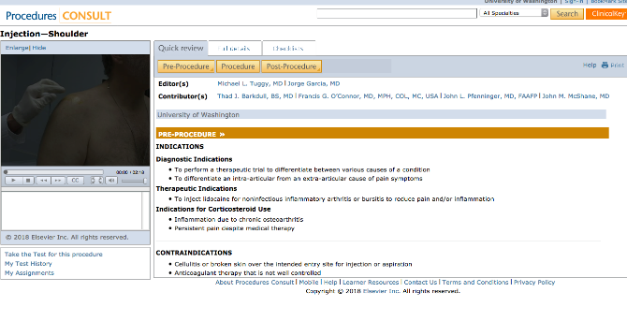
Do a procedure
Notes:
--lists by specialty
--includes video, quick review, full details, checklist and post procedure care/complications

Slide 19
Give a talk
There is concern about Lyme disease in your community and you are scheduled to give a presentation to your medical staff. You need to review the topic and would like to include images—good place for one stop shopping
--Look at Access Medicine, Clinical Key (as well as Google Images)

Slide 20
Alternative Medicines
Your 55 year old patient with Htn and dyslipidemia including hypertriglyceridemia wants to know if she should take Fish Oil
NATURAL MEDICINE DATABASE
--What is the product used for?
--Is it safe?
--Does it work?

