Slide 1
Creating a positive Learning Environment
Positive/Safe Learning Environment
Integration of Students into Clinical Learning Settings
Providing Formative and Summative Feedback

Slide 2
What is the Learning Environment?
The learning environment is the physical, social, and psychological context in which a student learns. A supportive learning environment contributes to student well-being and enhances student empathy, professionalism, and academic success, whereas an unsupportive learning environment may lead to burnout, exhaustion, and cynicism.

Slide 3
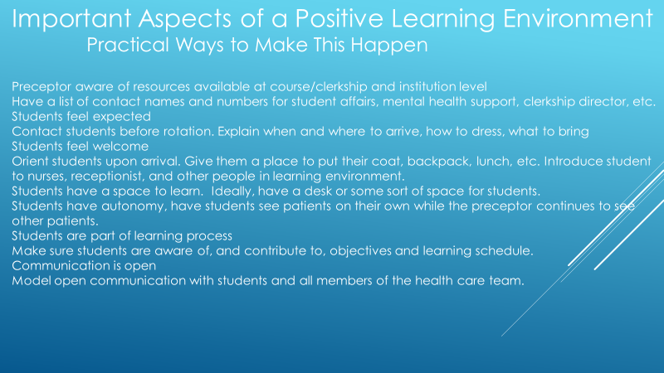

Slide 4
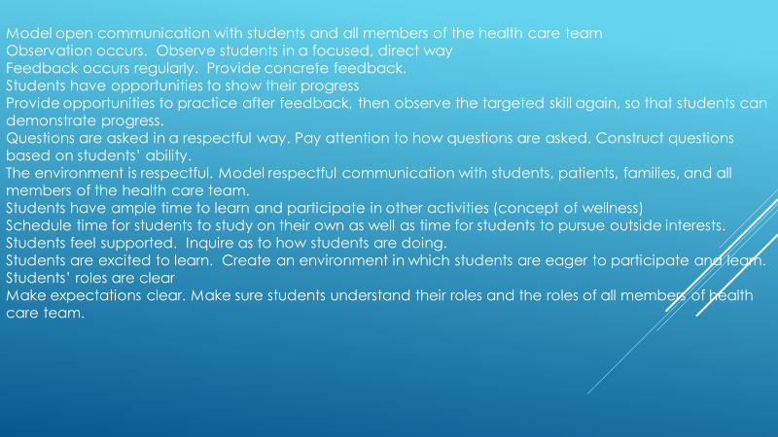

Slide 5
SAFE LEARNING ENVIRONMENT
STUDENT MISTREATMENT
The Association of American Medical Colleges (AAMC) identifies eight general areas of student mistreatment:
Public belittlement or humiliation
Threats of physical harm or actual physical punishment
Requirements to perform personal services, such as shopping
Being subjected to unwanted sexual advances
Being asked for sexual favors in exchange for grades
Being denied opportunities for training because of gender, race/ethnicity or sexual orientation
Being subjected to offensive remarks/names directed at you based on gender, race/ethnicity or sexual orientation
Receiving lower grades or evaluation based on gender, race/ethnicity or sexual orientation

Slide 6
Medicare Claims Processing Manual Chapter 12 - Physicians/Nonphysician Practitioners 100.1.1 - Evaluation and Management (E/M) Services (Rev. 3971, Issued: 02- 02- 18, Effective: 01-01-18, Implementation: 03- 05-18) B. E/M Service Documentation Provided By Students Any contribution and participation of a student to the performance of a billable service (other than the review of systems and/or past family/social history which are not separately billable, but are taken as part of an E/M service) must be performed in the physical presence of a teaching physician or physical presence of a resident in a service meeting the requirements set forth in this section for teaching physician billing. Students may document services in the medical record. However, the teaching physician must verify in the medical record all student documentation or findings, including history, physical exam and/or medical decision making. The teaching physician must personally perform (or re-perform) the physical exam and medical decision making activities of the E/M service being billed, but may verify any student documentation of them in the medical record, rather than re-documenting this work

Slide 8
SAFE LEARNING ENVIRONMENT
STUDENT MISTREATMENT
The Association of American Medical Colleges (AAMC) identifies eight general areas of student mistreatment:
Public belittlement or humiliation
Threats of physical harm or actual physical punishment
Requirements to perform personal services, such as shopping
Being subjected to unwanted sexual advances
Being asked for sexual favors in exchange for grades
Being denied opportunities for training because of gender, race/ethnicity or sexual orientation
Being subjected to offensive remarks/names directed at you based on gender, race/ethnicity or sexual orientation
Receiving lower grades or evaluation based on gender, race/ethnicity or sexual orientation

Slide 11
Set expectations
Establish mutual goals
Make it bidirectional
Reinforce the positive
Identify feedback
Safe
Environment

Slide 12
UNDERSTAND GENERATIONAL DIFFERENCES
Millennials Learn Differently than Previous Generations
Structured Upbringing
Concise communication using technology
Immediate gratification
Transparency in Relationships

Slide 13
SAFE LEARNING Environment
Students Will Learn And Function Best When…
  Students have structure
    SET EXPECTATIONS
    Give tasks and explain the context and reasoning behind the task – this will support autonomy in the future
  Students have a structure that allows them to take responsibility
    Allow autonomy and allow students to know they have autonomy – this conveys trust
    Allow ownership – ownership enables the hardest work
  Students have a supportive environment
    Be available and provide support – Avoid paternalistic or authoritarian approach
    Praise and positive reinforcement → everyone needs to succeed a little each day
  Students need expert coaching
    Precepting = coaching
Kackman, J. Leading Teams. 2002. Harvard Business School Publishing Co. Boston.
Dutton, J. Energize Your Workplace. 2003. John Wiley & Sons, Inc. Hoboken, NJ.

Slide 14
Feedback is the opportunity to turn an assessment into a vehicle for growth for the learner
Assessment is the opportunity to consider the stage and progress of the learner. It flows naturally once expectations are set

